Slide 1
Lecture 1: Introduction to Regression

Slide 2
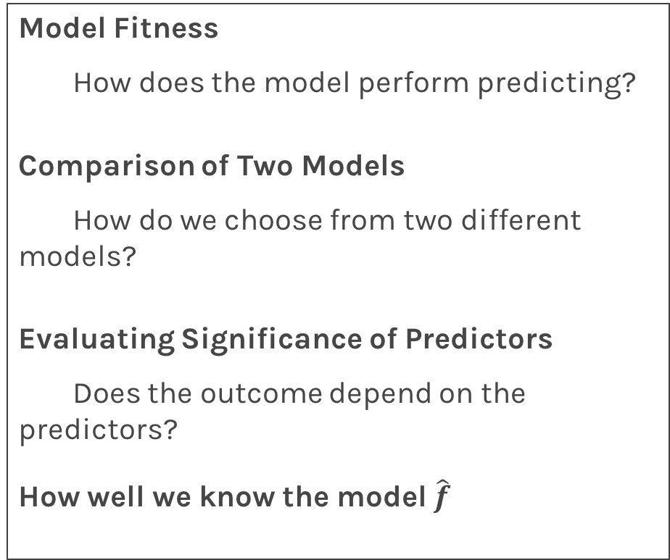
Lecture Outline
Logistics
Program Structure
Data
Statistical Modeling I
k-Nearest Neighbors (kNN)
Statistical Modeling II
Linear Regression
Model Fitness
How does the model perform predicting?
Comparison of Two Models
How do we choose from two different models?
Evaluating Significance of Predictors
Does the outcome depend on the predictors?
How well we know the model $\hat{f}$

Slide 3
Class Logistics

Slide 4
What
Lectures: Eight lectures
Day 1: Regression: Linear and kNN
Day 2: Classification: Logistic and kNN
Day 3: Decision trees: Bagging, Random Forest and Boosting
Day 4: Deep Neural Networks: Feed Forward, CNN
Labs: Eight Labs. Labs will provide practical examples to help you understand the material.
Project: Select from one of the provided projects and work in a group.

Slide 5
Who
Valérie Gauthier, Universidad del Rosario, Mathematician from Universidad de los Andes, Bogota, Colombia. She obtained her PhD in applied mathematics, in the area of post-quantum cryptography from Danmarks Tekniske Universitet (DTU). She is the head of the Applied Mathematics and Computer Science Department at Universidad del Rosario, Bogotá, Colombia.

Slide 6
Who
Julián Rincón, Universidad del Rosario. He has a Ph.D. in computational physics, modeling and algorithms design from Instituto Balseiro Centro Atómico de Bariloche, Argentina. His is an Assistant Professor at Universidad del Rosario, Colombia, Department of Applied Mathematics and Computer Science.
.

Slide 7
Who
Juan F. Perez, Assistant Professor in AM and CS at Universidad del Rosario. He obtained a PhD in Computer Science from the University of Antwerp, Belgium. He was a Research Associate in performance analysis at Imperial College and the University of Melbourne, Australia. His interests center around the performance analysis of computer systems, especially on software applications, cloud and cluster computing, and optical networking.

Slide 8
Who
Dora Suárez, Universidad del Rosario. She is a Teaching and Research Fellow at Universidad del Rosario, Colombia. She obtained a Bachelor degree in Statistics from Universidad Nacional, Colombia, and the Master's degree in Statistics from the Federal University of Pernambuco, Brazil. Her current interests are in the areas of data analysis, programming, and graphical design.
.

Slide 9
Who
Luis Felipe Giraldo, Universidad de los Andes. Luis received his PhD. degree in Electrical and Computer Engineering at The Ohio State University, USA, in 2016. His current research interests include design and analysis of interconnected dynamical systems, large-scale processing of signals, and humanitarian engineering.
.

Slide 10
Who
Germán Obando, Universidad del Rosario. Germán received his Ph.D. degree from Ecole des Mines de Nantes, France and U. de los Andes in 2016. He was a postdoctoral Fellow with the Research Group in Control and Automation Systems at Universidad de los Andes. He is currently an Assistant Professor in AM and CS. His current research interests include distributed optimization, population dynamics, and game theory.
.

Slide 11
Who
Rafael Martinez Galarza: Harvard-Smithsonian Center for Astrophysics , PhD Leiden 2012. His research focuses on star formation and time-domain astronomy. He is a member of the LSST Transients and Variable Stars collaborations, where he has been doing preparatory work for the LSST survey, including ML classification.

Slide 12

Who
Pavlos Protopapas, Scientific Director of the Institute for Applied Computational Science (IACS). Teaches Data Science1 and Data Science 2 at Harvard. His research is in astrostatistics and he is excited about the new telescopes coming online in the next few years.

Slide 13
How - Schedule
Time | Activity
Lecture 1 | 9.00-10.30
Break | 10.30-11.00
Lab 1 | 11.00-12.00
Exercises 1 | 12.00-13.00
Lunch | 13.00-14.00
Lecture 2 | 14.00-15.30
Break | 15.30-16.00
Lab 2 | 16.00-17.00
Exercises 2 | 17.00-18.00

Slide 14
Data Science

Slide 15

Why?

Slide 16
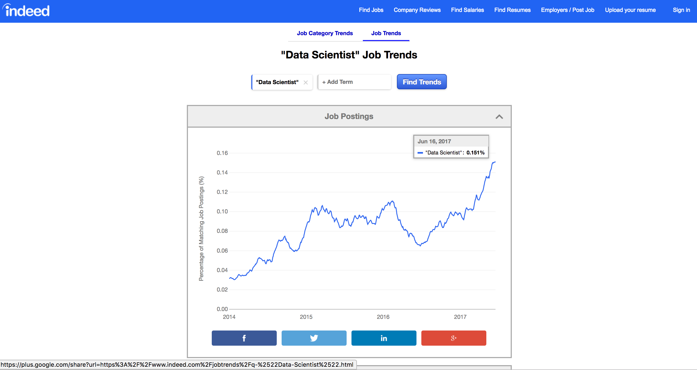
Why?

Slide 17
Why?

Slide 18
Data Science Process

Slide 19
Let’s start

Slide 20
Predicting a Variable
Let's image a scenario where we'd like to predict one variable using another (or a set of other) variables.
Examples:
Predicting the amount of view a YouTube video will get next week based on video length, the date it was posted, previous number of views, etc.
Predicting which movies a Netflix user will rate highly based on their previous movie ratings, demographic data etc.

Slide 21
Data

Slide 22
Data
The Advertising data set consists of the sales of that product in 200 different markets, along with advertising budgets for the product in each of those markets for three different media: TV, radio, and newspaper. Everything is given in units of $1000.
,
TV | radio | newspaper | sales
230.1 | 37.8 | 69.2 | 22.1
44.5 | 39.3 | 45.1 | 10.4
17.2 | 45.9 | 69.3 | 9.3
151.5 | 41.3 | 58.5 | 18.5
180.8 | 10.8 | 58.4 | 12.9
Some of the figures in this presentation are taken from "An Introduction to Statistical Learning, with applications in R" (Springer, 2013) with permission from the authors: G. James, D. Witten, T. Hastie and R. Tibshirani "
Notes:
Supposed we were asked by a client to provide advice on how to improve sales of a particular product.
Does that footnote belong on this slide?

Slide 23
Response vs. Predictor Variables
There is an asymmetry in many of these problems:
The variable we'd like to predict may be more difficult to measure, is more important than the other(s), or may be directly or indirectly influenced by the values of the other variable(s).
Thus, we'd like to define two categories of variables:
variables whose value we want to predict
variables whose values we use to make our prediction.
Notes:
Give an example

Slide 24
Response vs. Predictor Variables
X
predictors
features
covariates
Y
outcome
response variable
dependent variable
TV | radio | newspaper | sales
230.1 | 37.8 | 69.2 | 22.1
44.5 | 39.3 | 45.1 | 10.4
17.2 | 45.9 | 69.3 | 9.3
151.5 | 41.3 | 58.5 | 18.5
180.8 | 10.8 | 58.4 | 12.9
n observations
p predictors

Slide 25
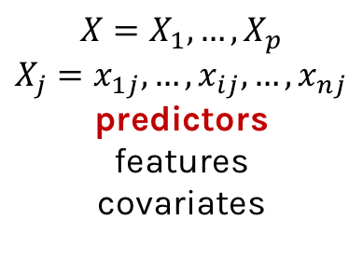
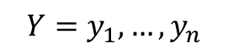
Response vs. Predictor Variables
$$X=X_{1},…,X_{p}$$
$$X_{j}=x_{1j},…,x_{ij},…,x_{nj}$$
predictors
features
covariates
outcome
response variable
dependent variable
$$Y=y_{1},…,y_{n}$$
TV | radio | newspaper | sales
230.1 | 37.8 | 69.2 | 22.1
44.5 | 39.3 | 45.1 | 10.4
17.2 | 45.9 | 69.3 | 9.3
151.5 | 41.3 | 58.5 | 18.5
180.8 | 10.8 | 58.4 | 12.9
n observations
p predictors
Notes:
I changed y_p to y_n. I think this makes the dimensions correct now. (DLS)

Slide 26
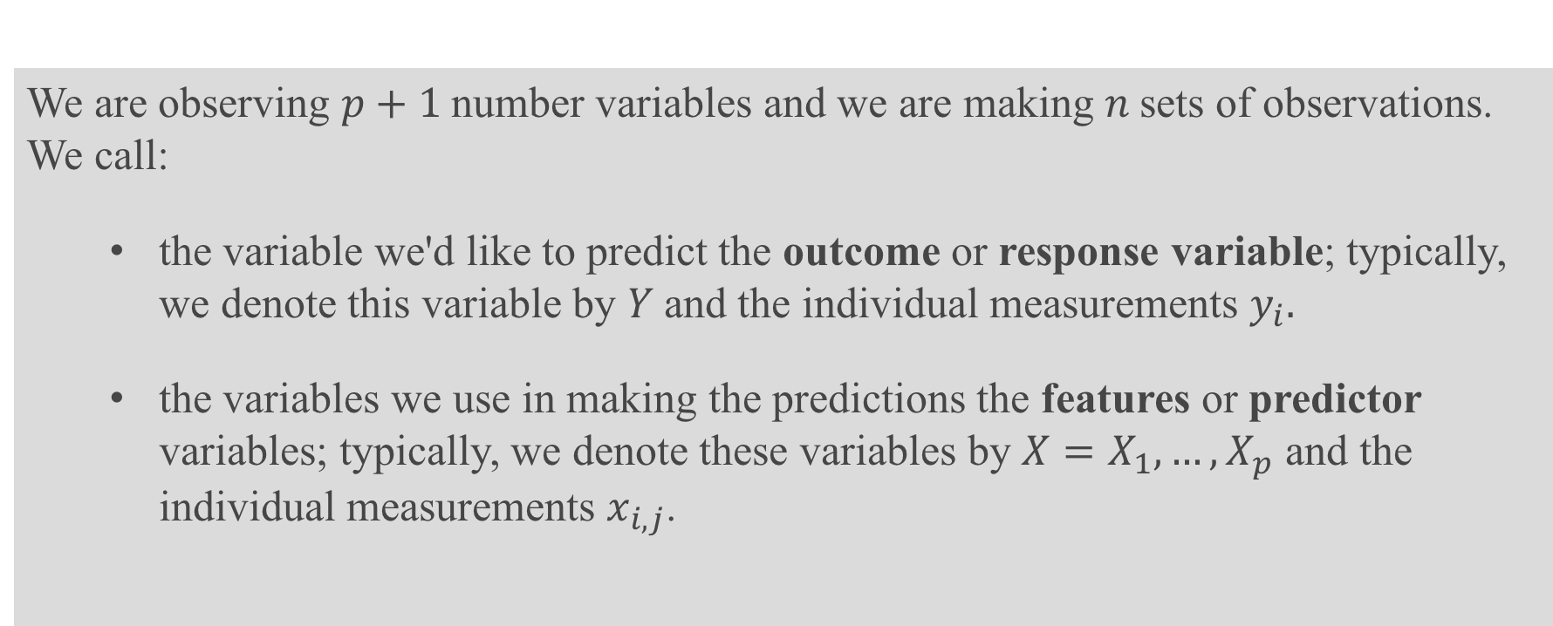
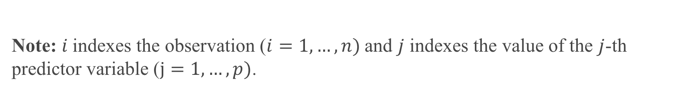
Definition
We are observing $p+1$number variables and we are making $n$sets of observations. We call:
the variable we'd like to predict the outcome or response variable; typically, we denote this variable by $Y$and the individual measurements $y_{i}.$
the variables we use in making the predictions the features or predictor variables; typically, we denote these variables by $X=X_{1},…,X_{p}$ and the individual measurements $x_{i,j}$.
Note: $i$indexes the observation ($i=1,…,n)$and $j$ indexes the value of the $j$-th predictor variable ($j=1,…,p)$.

Slide 27
Statistical Model

Slide 28
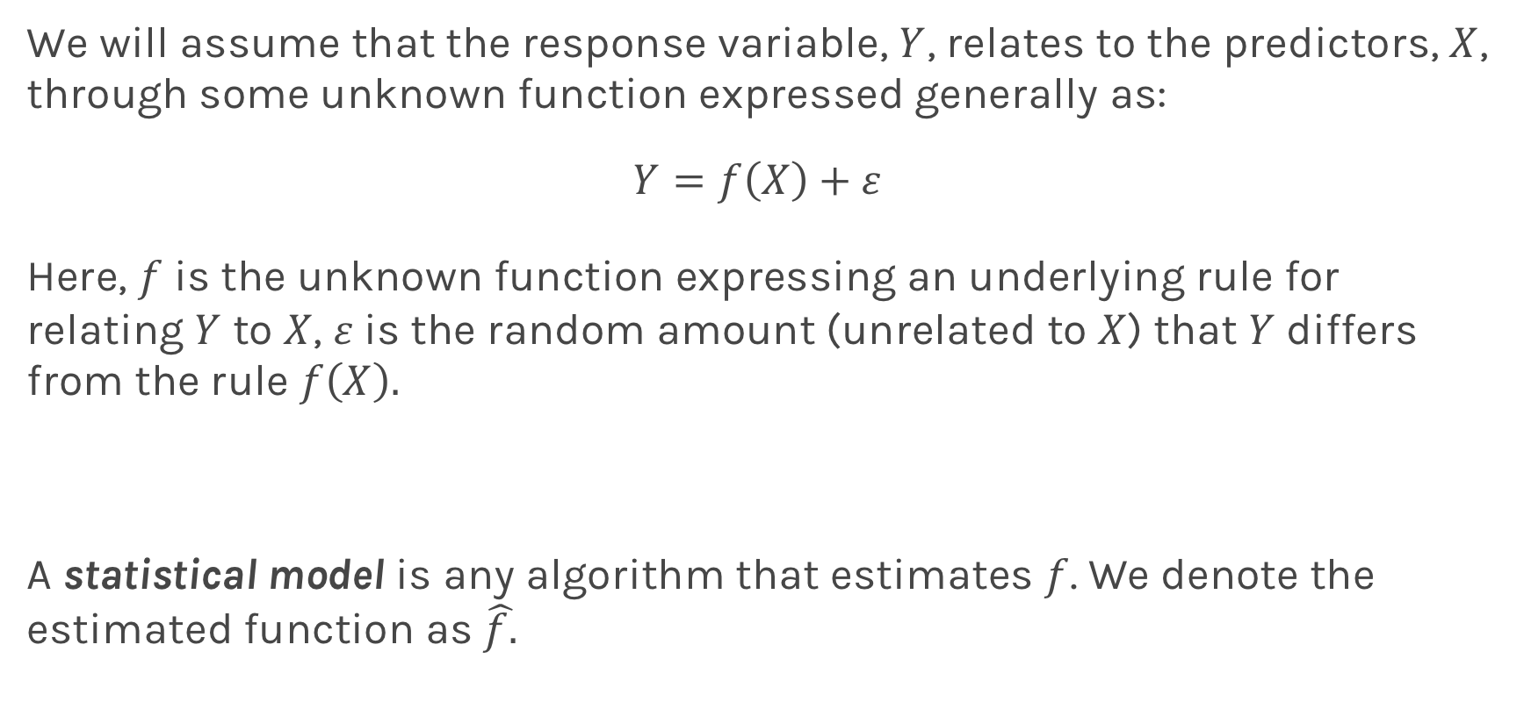
True vs. Statistical Model
We will assume that the response variable, $Y$, relates to the predictors, $X$, through some unknown function expressed generally as:
$$Y=f\left(X\right)+ε$$
Here, $f$ is the unknown function expressing an underlying rule for relating $Y$ to $X$, $ε$is the random amount (unrelated to $X$) that $Y$ differs from the rule $f\left(X\right).$
A statistical model is any algorithm that estimates $f$. We denote the estimated function as $\hat{f.}$
Notes:
Change x and y to uppercase? (DLS)

Slide 29
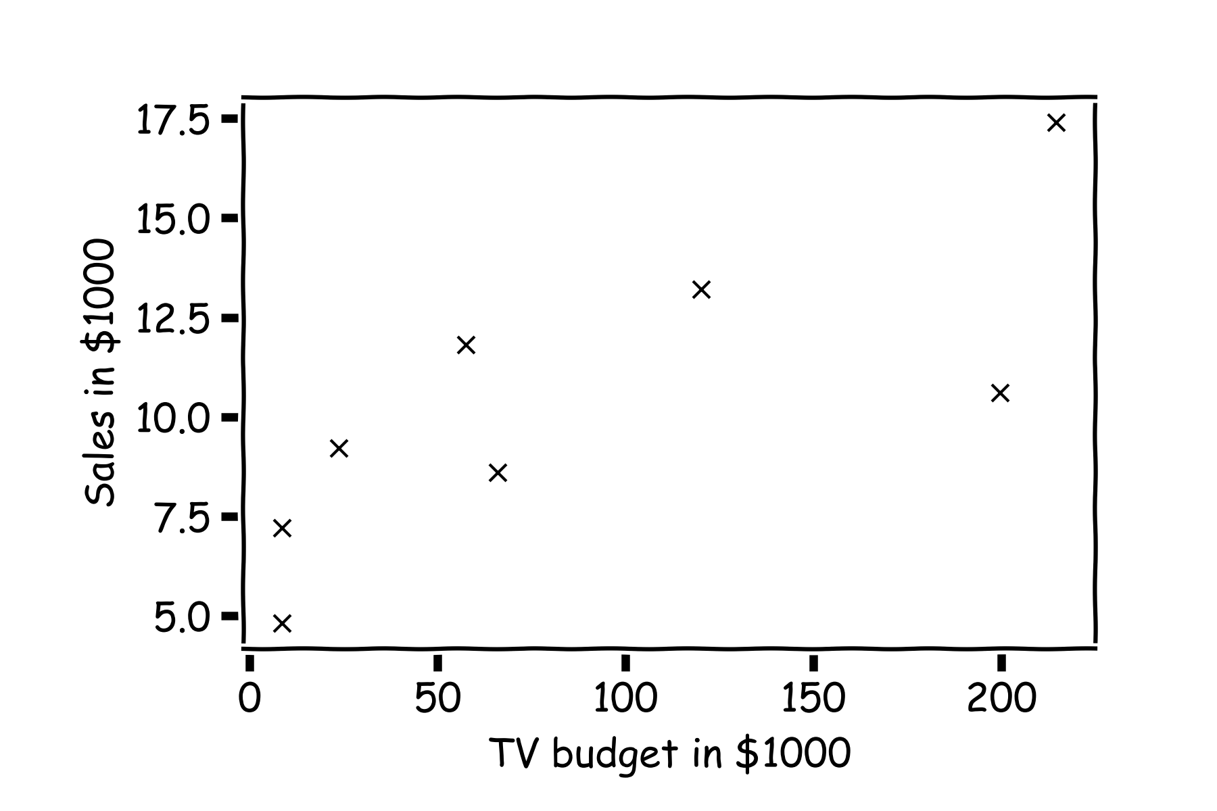
Statistical Model
y
x

Slide 30
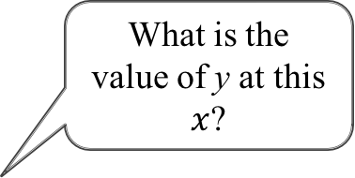
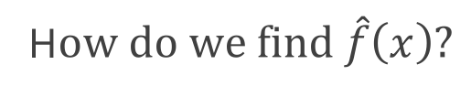
Statistical Model
H$ow do we find \hat{f}\left(x\right)?$
What is the value of y at this $x$?

Slide 31
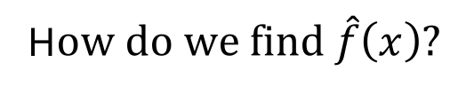
Statistical Model
H$ow do we find \hat{f}\left(x\right)?$
or here?

Slide 32
Statistical Model
Simple idea is to take the mean of all y’s, $\hat{f}\left(x\right)=\frac{1}{n}\sum_{1}^{n}{y_{i}}$

Slide 33
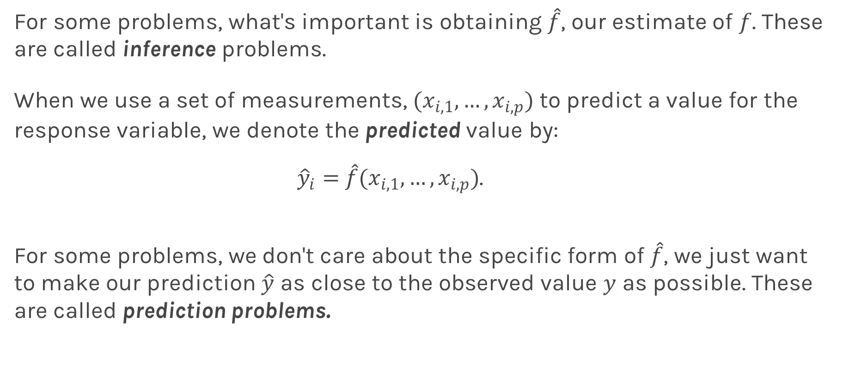
Prediction vs. Estimation
For some problems, what's important is obtaining $\hat{f}$, our estimate of $f$. These are called inference problems.
When we use a set of measurements, $(x_{i,1}, …,x_{i,p})$ to predict a value for the response variable, we denote the predicted value by:
${\hat{y}}_{i}=$ $\hat{f}(x_{i,1}, …,x_{i,p})$.
For some problems, we don't care about the specific form of $\hat{f}$, we just want to make our prediction $\hat{y}$ as close to the observed value $y$ as possible. These are called prediction problems.

Slide 34
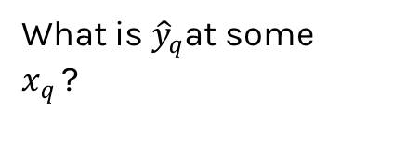
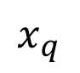
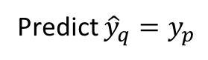
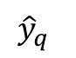
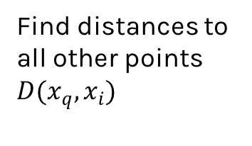
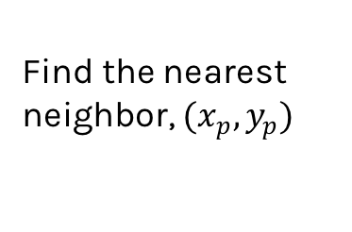
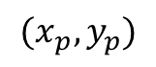
Simple Prediction Model
What is ${\hat{y}}_{q}$at some $x_{q }$?
Find distances to all other points $D(x_{q},x_{i})$
$${(x}_{p},y_{p})$$
$${\hat{y}}_{q}$$
Find the nearest neighbor, ${(x}_{p},y_{p})$
Predict ${\hat{y}}_{q}=y_{p}$
$$x_{q}$$
Notes:
Is it clear that x_q is really x_i,q? (DLS)

Slide 35
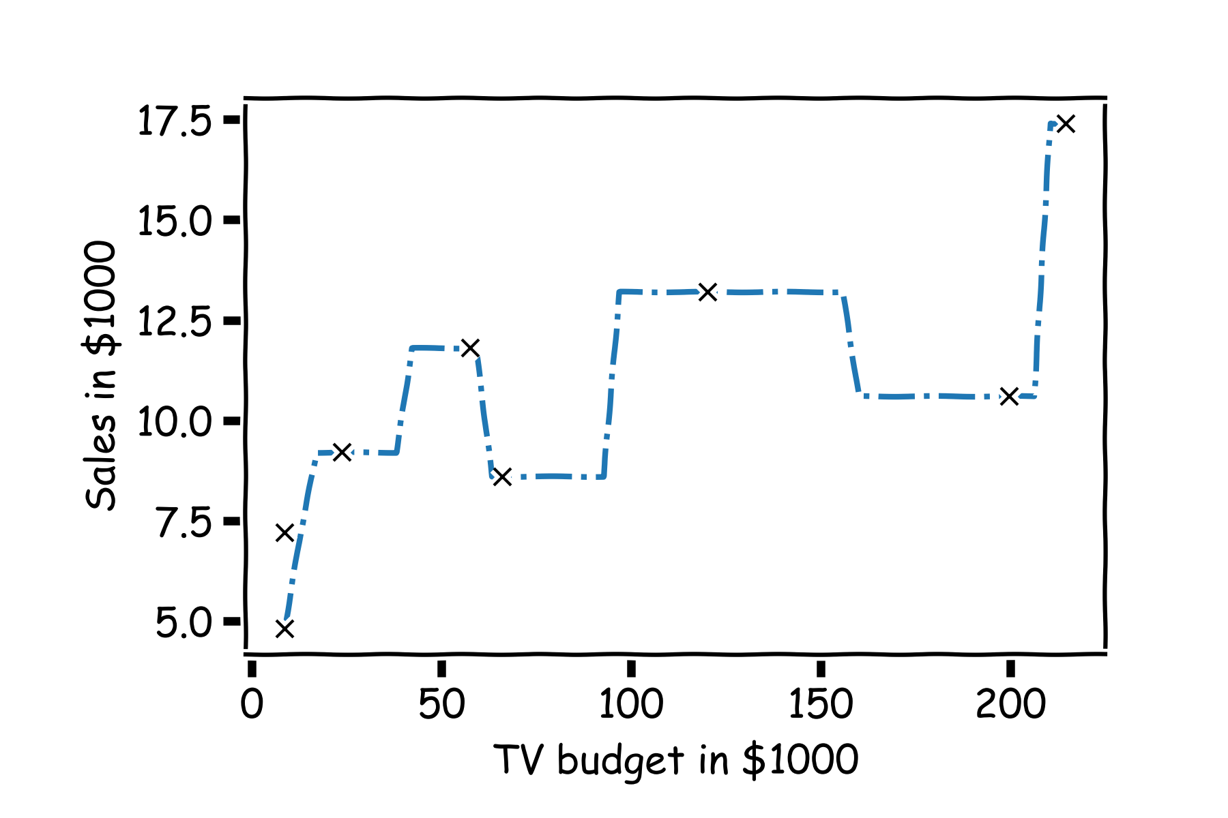
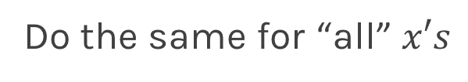
Simple Prediction Model
Do the same for “all” $x′s$

Slide 36
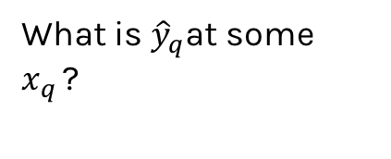
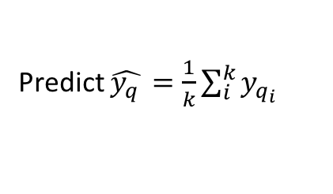
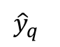
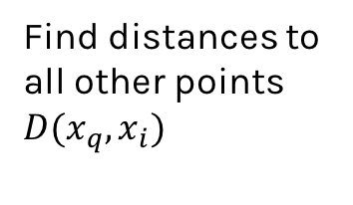
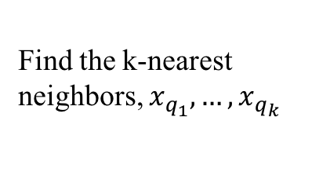
Extend the Prediction Model
What is ${\hat{y}}_{q}$at some $x_{q }$?
Find distances to all other points $D(x_{q},x_{i})$
$${\hat{y}}_{q}$$
Find the k-nearest neighbors, $x_{q_{1}},…,x_{q_{k}}$
Predict $\hat{y_{q }}=\frac{1}{k}\sum_{i}^{k}{y_{q_{i}}}$
$$x_{q}$$
Notes:
Change indeces and show k-nearest

Slide 37
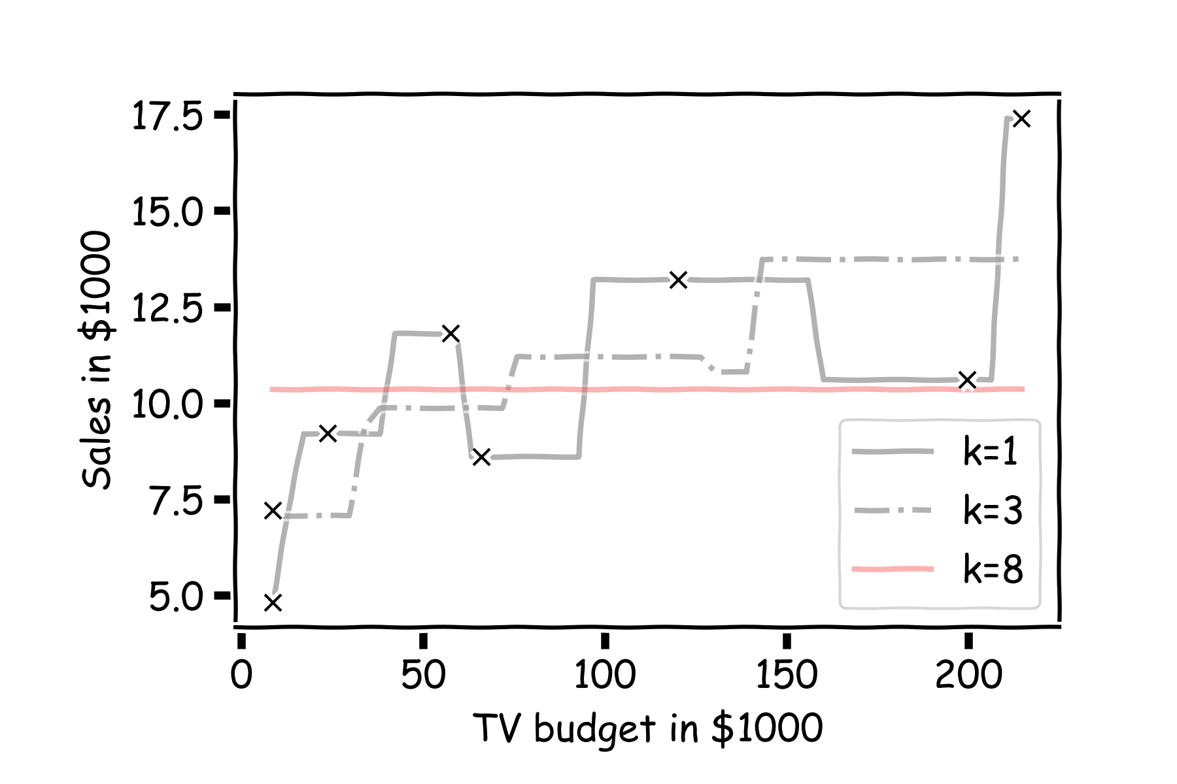
Simple Prediction Models
Notes:
Change indeces and show k-nearest

Slide 38

Simple Prediction Models
Same models on more data
Notes:
Change indeces and show k-nearest

Slide 39
k-Nearest Neighbors
The k-Nearest Neighbor (kNN) model is an intuitive way to predict a quantitative response variable:
to predict a response for a set of observed predictor values, we use the responses of other observations most similar to it
Note: this strategy can also be applied in classification to predict a categorical variable. We will encounter kNN again later in the course in the context of classification.
Notes:
Change indeces and show k-nearest

Slide 40
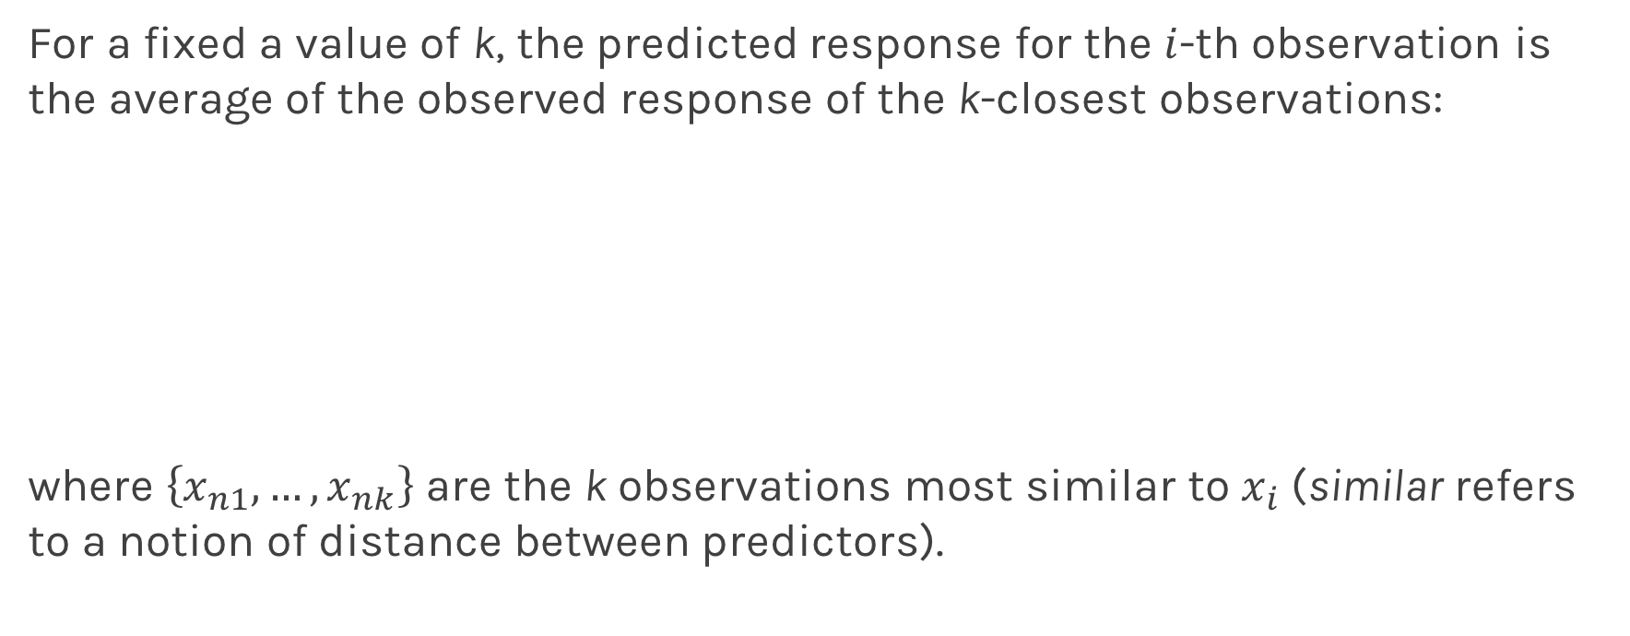
k-Nearest Neighbors - kNN
For a fixed a value of k, the predicted response for the $i$-th observation is the average of the observed response of the k-closest observations:
where $\left\{x_{n1},…,x_{nk}\right\}$ are the k observations most similar to $x_{i}$ (similar refers to a notion of distance between predictors).
Notes:
Notice y_hat instead of f_hat
I think the index on y_hat is wrong but I can’t change it b/c it’s an image. (DLS)

Slide 41
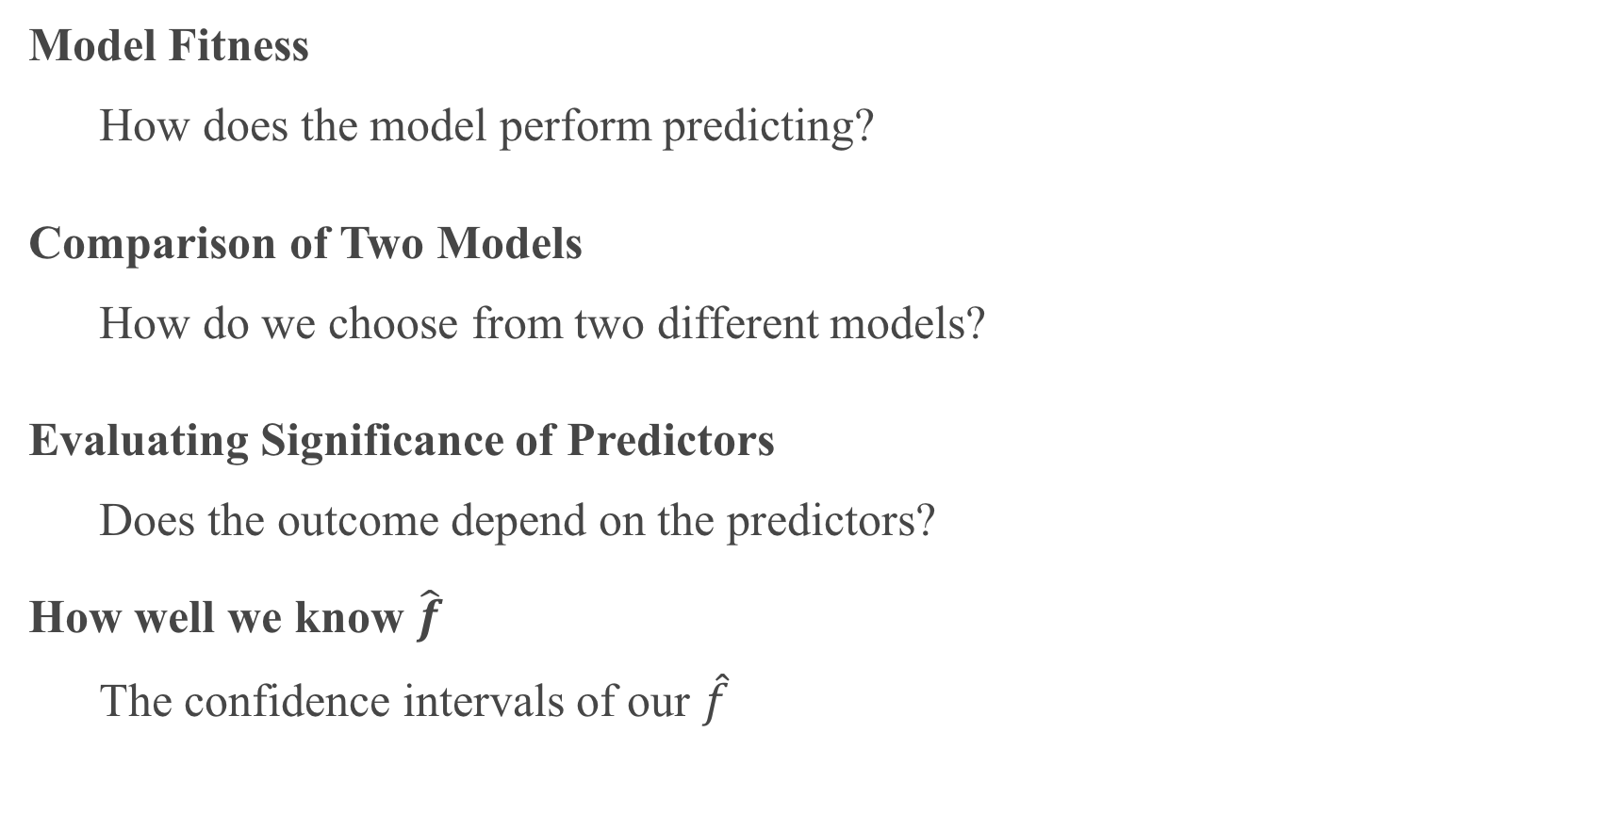
Things to Consider
Model Fitness
How does the model perform predicting?
Comparison of Two Models
How do we choose from two different models?
Evaluating Significance of Predictors
Does the outcome depend on the predictors?
How well we know $\hat{f}$
The confidence intervals of our $\hat{f}$

Slide 42
Error Evaluation

Slide 43
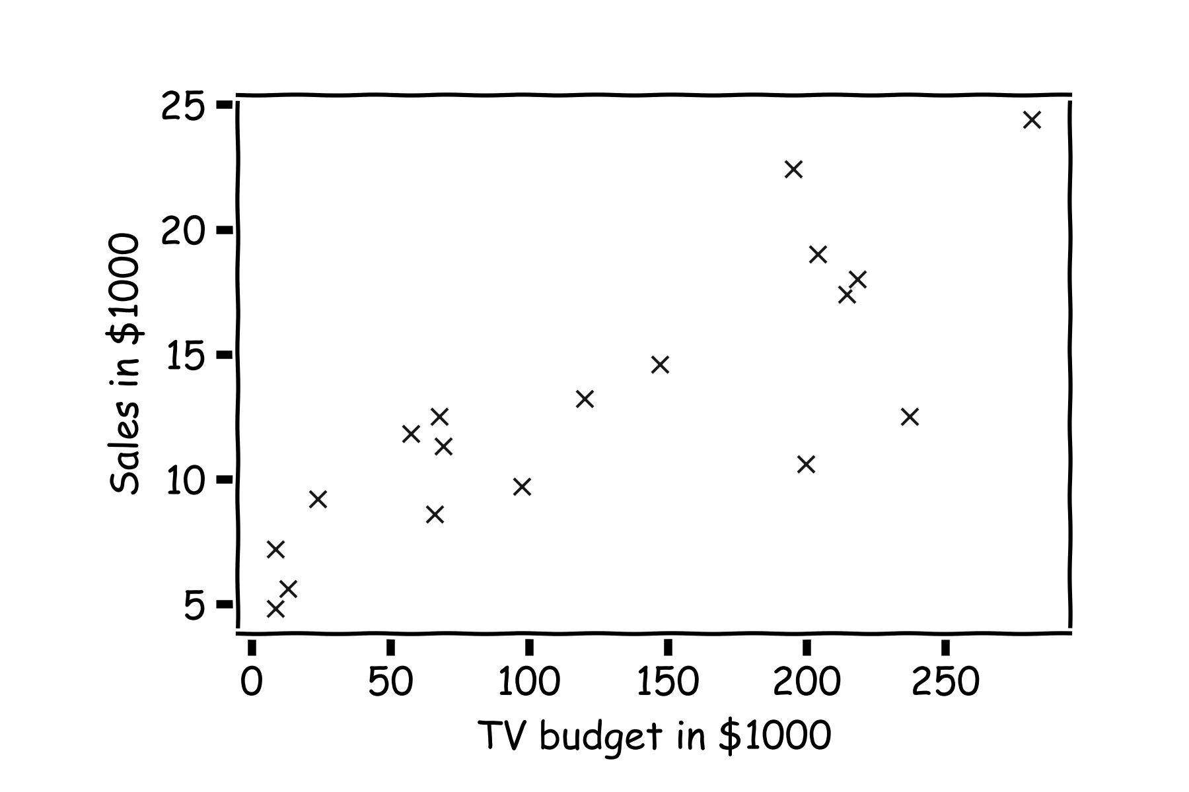
Error Evaluation
Start with some data.
Notes:
Change indeces and show k-nearest

Slide 44
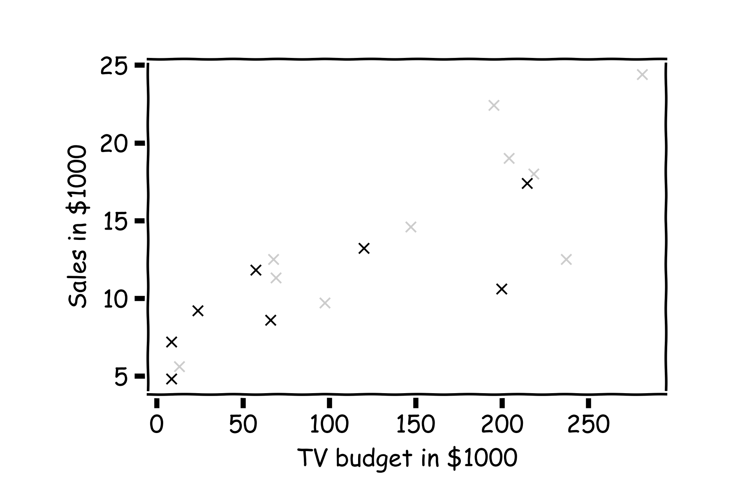
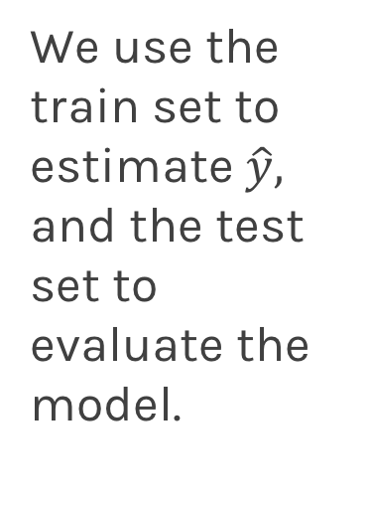
Error Evaluation
Hide some of the data from the model. This is called train-test split.
We use the train set to estimate $\hat{y},$ and the test set to evaluate the model.

Slide 45
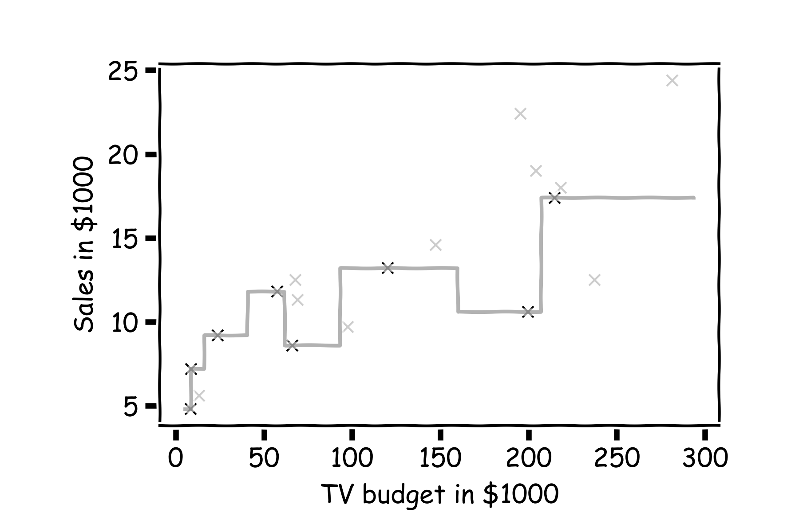
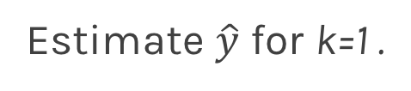
Error Evaluation
Estimate $\hat{y}$ for k=1 .
Notes:
Change indeces and show k-nearest

Slide 46
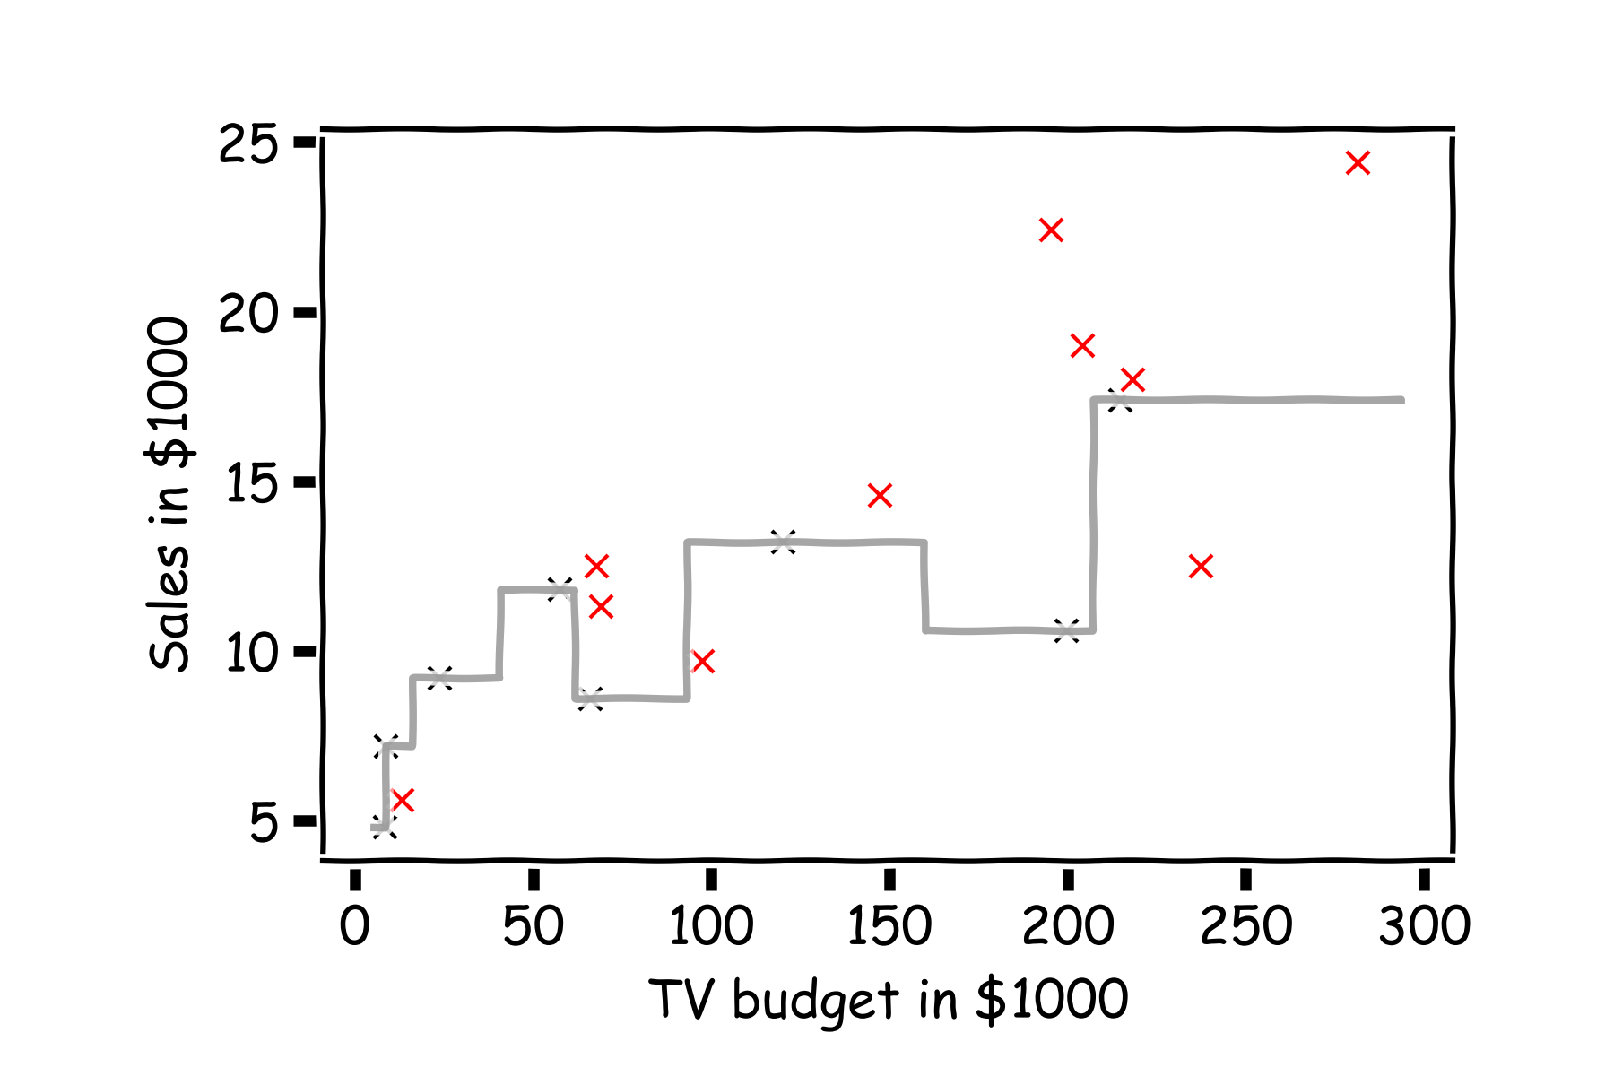
Error Evaluation
Now, we look at the data we have not used, the test data (red crosses).

Slide 47
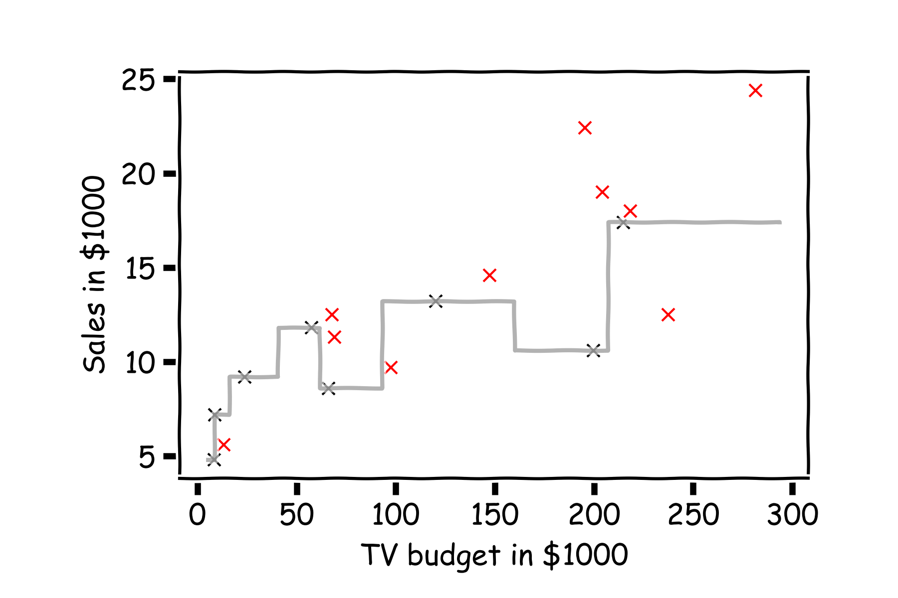
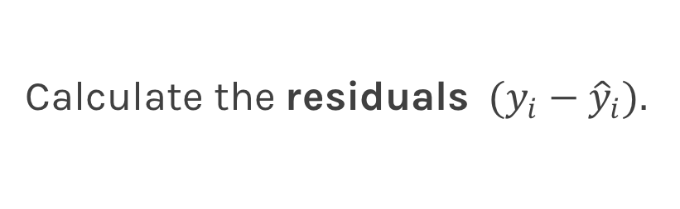
Error Evaluation
Calculate the ${\text{residuals} (y}_{i}−{\hat{y}}_{i}).$
Notes:
Change indeces and show k-nearest

Slide 48
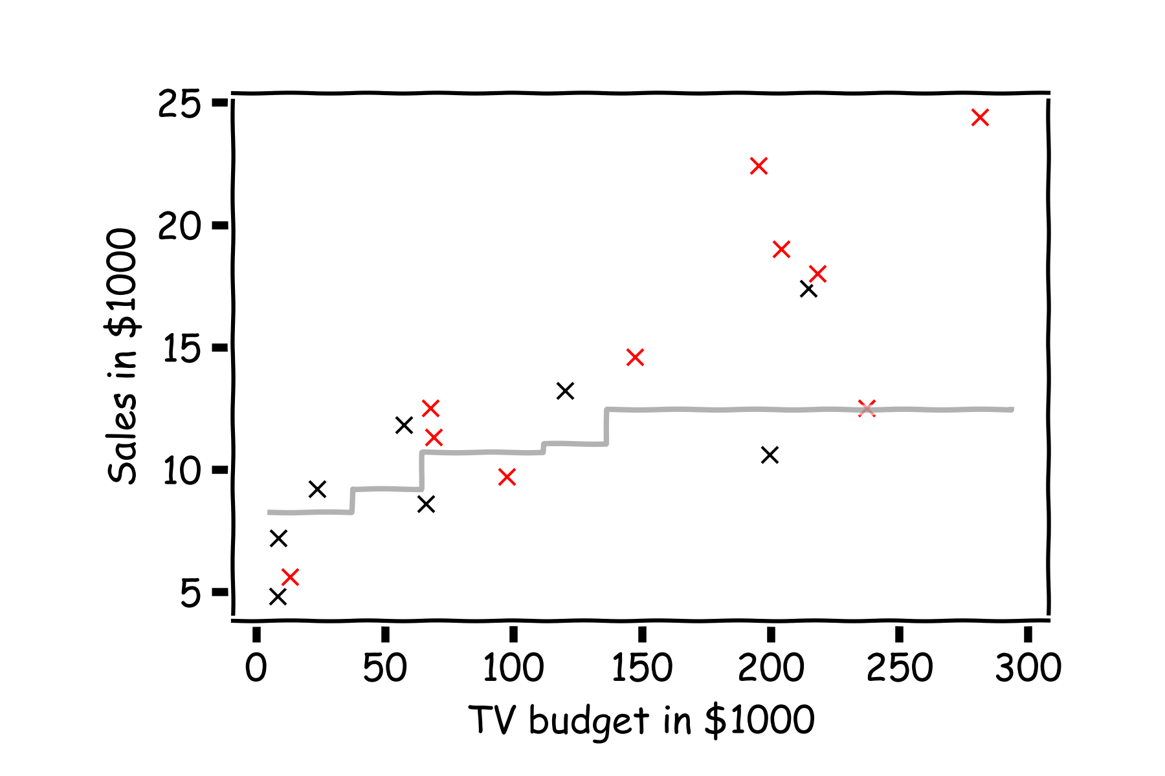
Error Evaluation
Do the same for k=3.
Notes:
Change indeces and show k-nearest

Slide 49
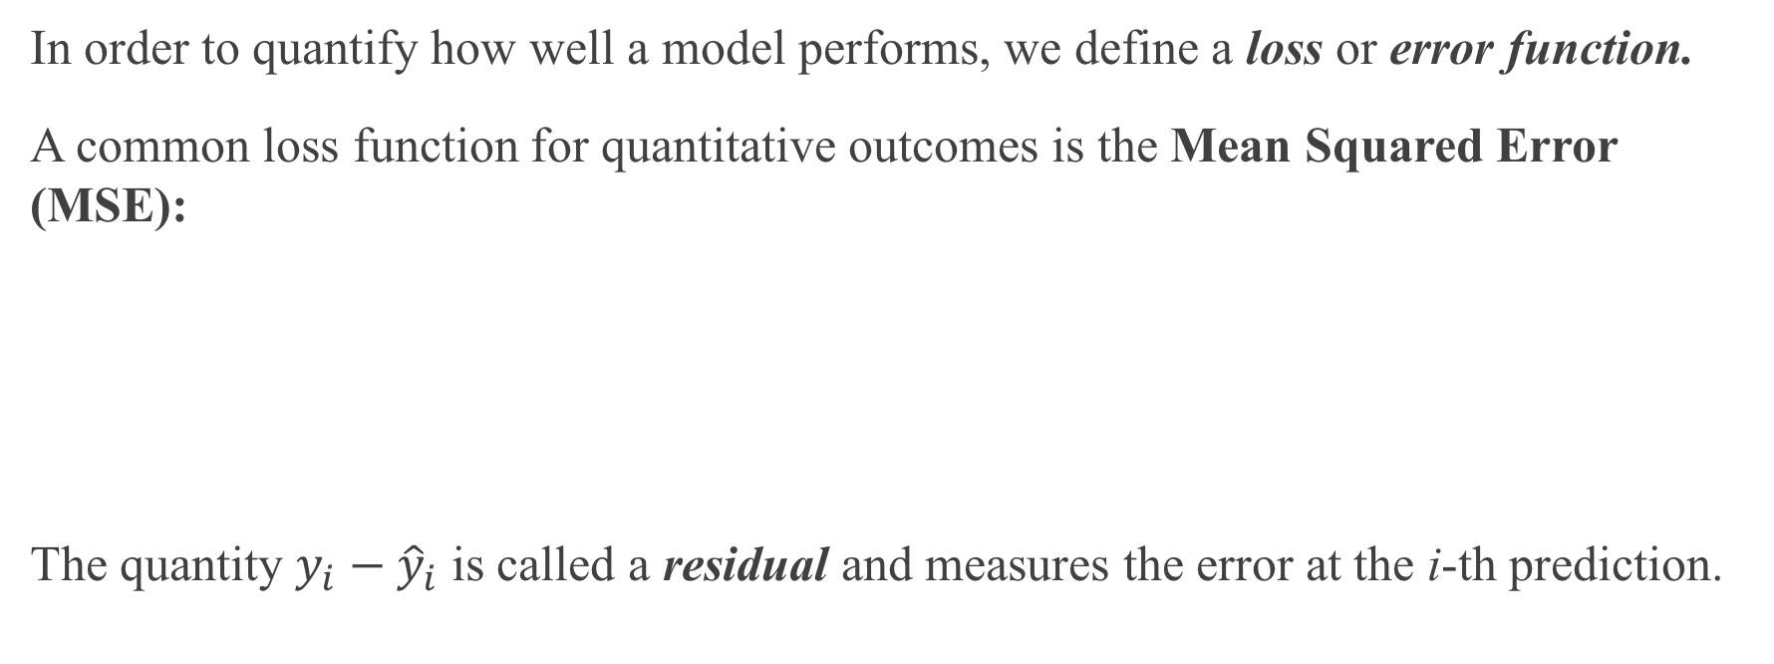
Error Evaluation
In order to quantify how well a model performs, we define a loss or error function.
A common loss function for quantitative outcomes is the Mean Squared Error (MSE):
The quantity $y_{i}−{\hat{y}}_{i}$ is called a residual and measures the error at the i-th prediction.
Notes:
Change indeces and show k-nearest

Slide 50
Error Evaluation
Caution: The MSE is by no means the only valid (or the best) loss function!
Question: What would be an intuitive loss function for predicting categorical outcomes?
Note: The square Root of the Mean of the Squared Errors (RMSE) is also commonly used.
Notes:
Change indeces and show k-nearest
Do you want to mention that RMSE isn’t always great b/c it’s not smooth? This would give them an idea on the things to consider when choosing loss functions. (DLS)

Slide 51
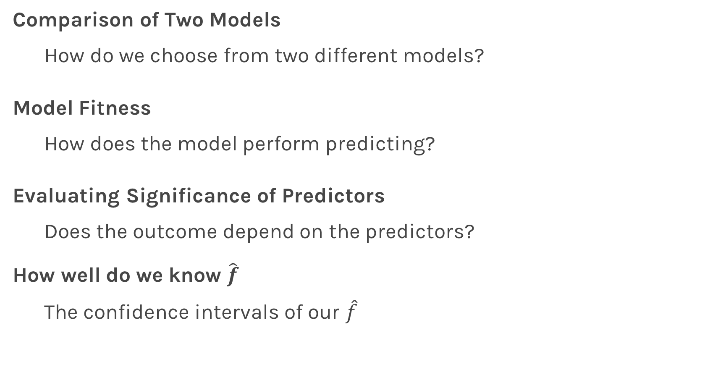
Things to Consider
Comparison of Two Models
How do we choose from two different models?
Model Fitness
How does the model perform predicting?
Evaluating Significance of Predictors
Does the outcome depend on the predictors?
How well do we know $\hat{f}$
The confidence intervals of our $\hat{f}$

Slide 52
Model Comparison

Slide 53
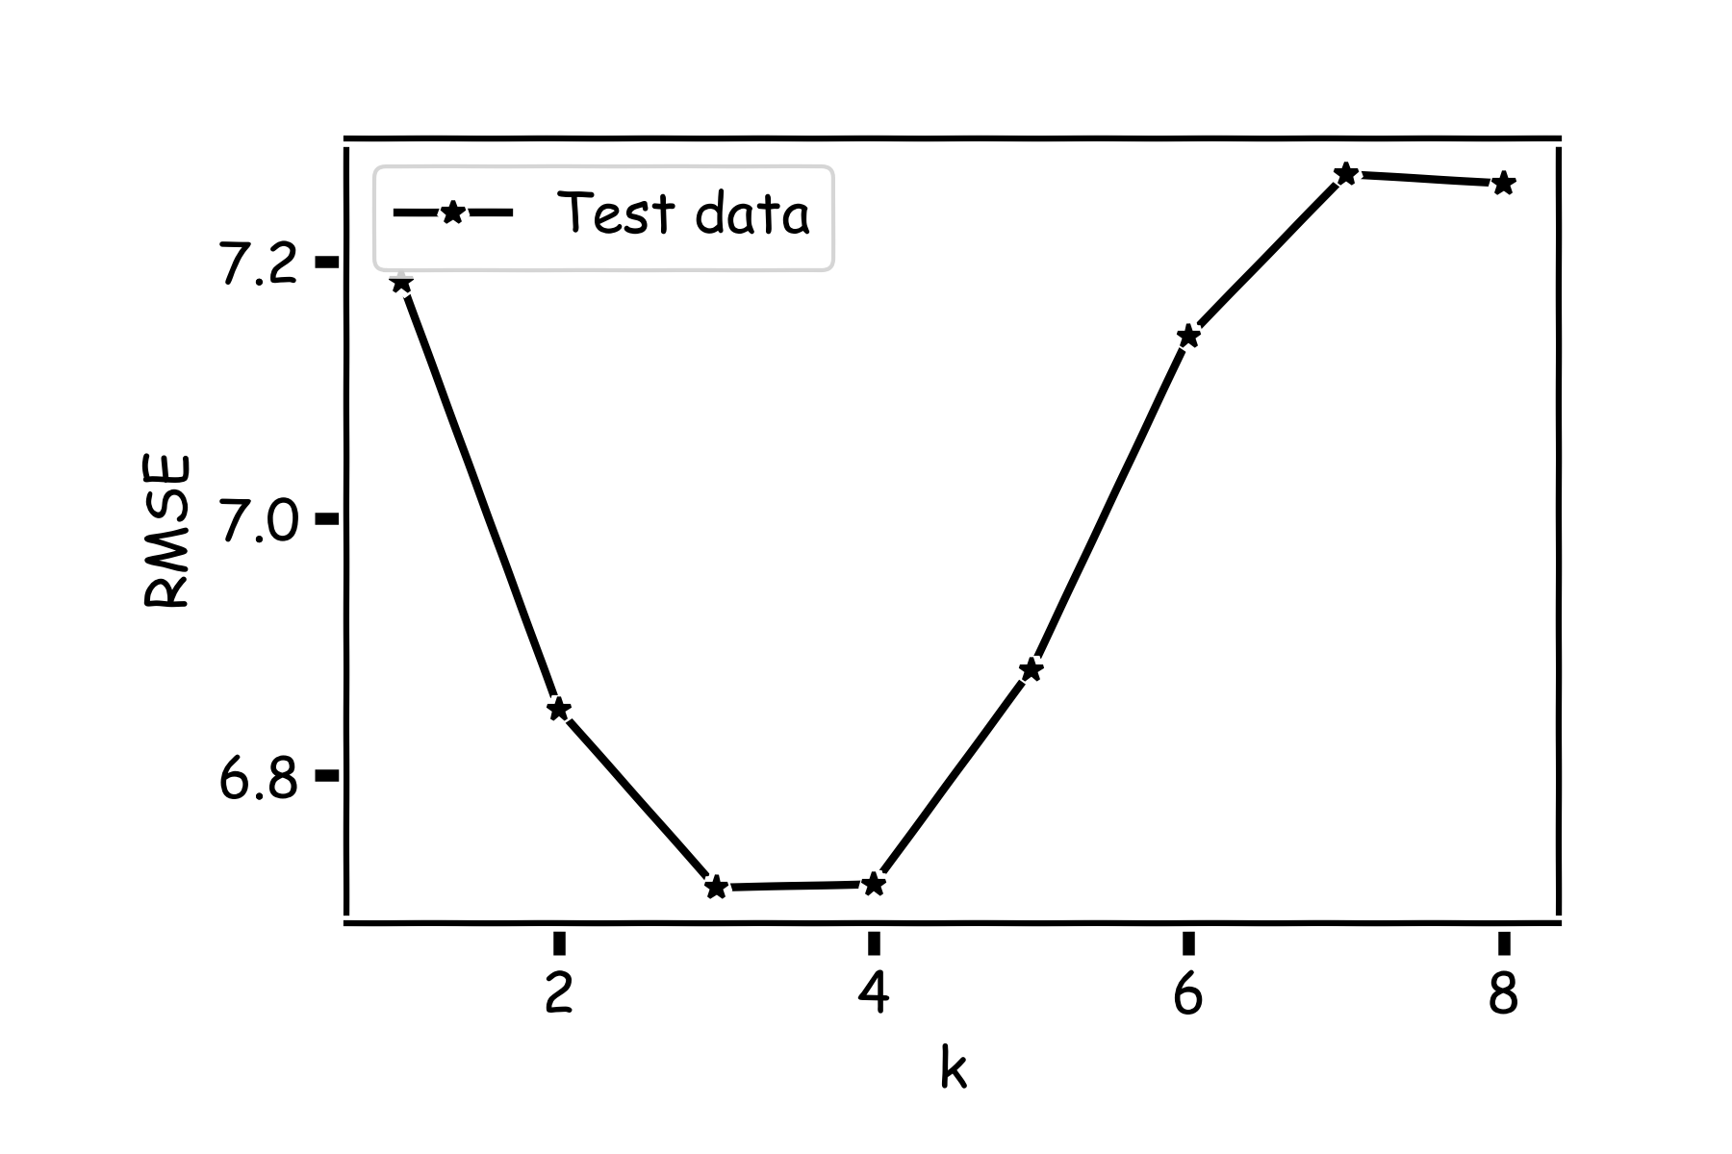
Model Comparison
Do the same for all k’s and compare the RMSEs. k=3 seems to be the best model.

Slide 54
Things to Consider
Comparison of Two Models
How do we choose from two different models?
Model Fitness
How does the model perform predicting?
Evaluating Significance of Predictors
Does the outcome depend on the predictors?
How well do we know $\hat{f}$
The confidence intervals of our $\hat{f}$

Slide 55
Model Fitness

Slide 56
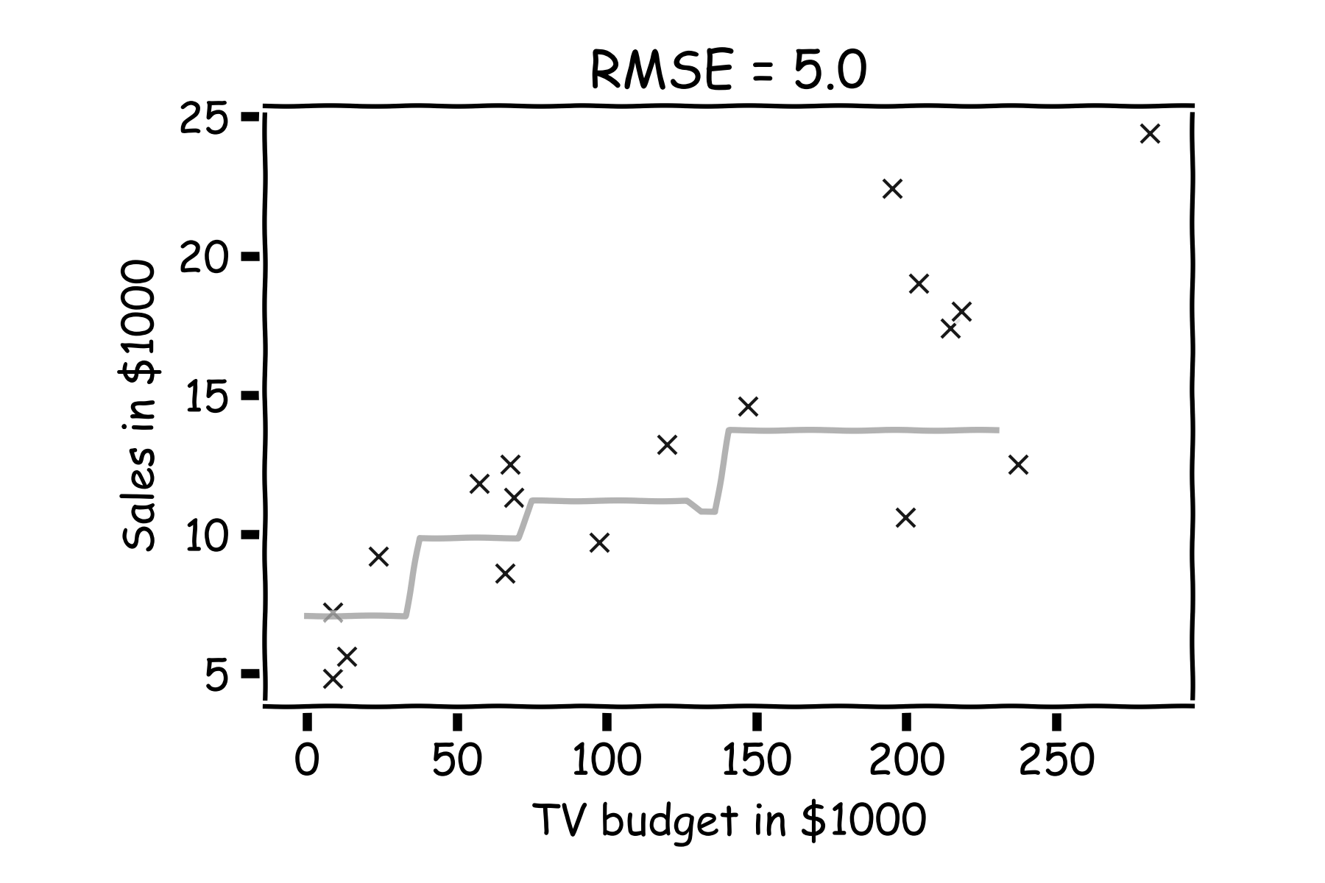
Model fitness
For a subset of the data, calculate the RMSE for k=3. Is RMSE=5.0 good enough?

Slide 57
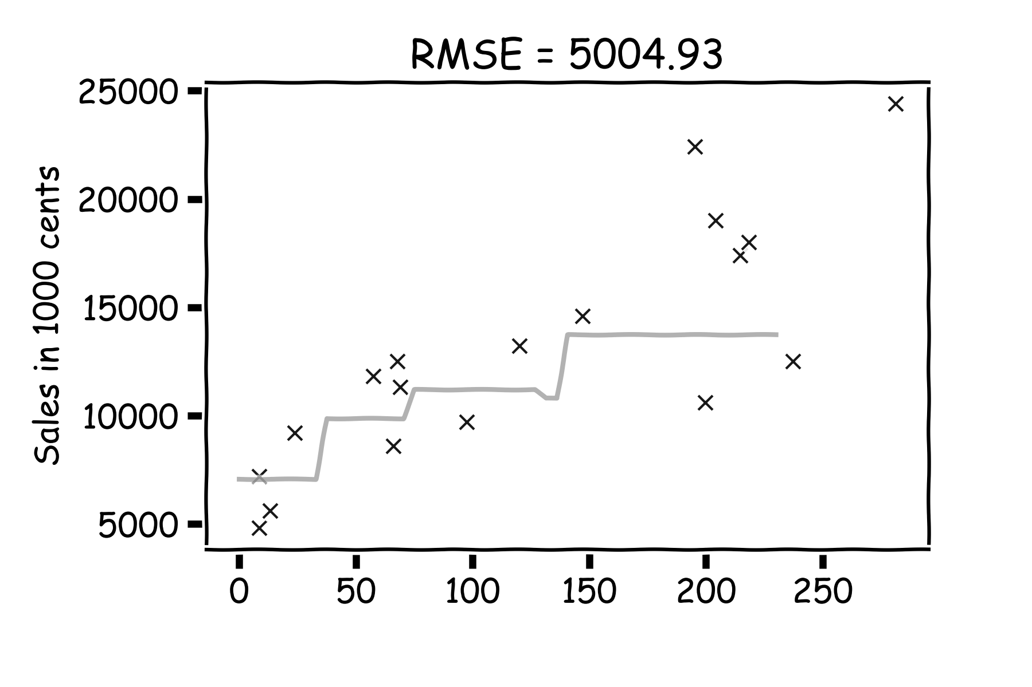
Model fitness
What if we measure the Sales in cents instead of dollars?
RMSE is now 5004.93.
Is that good?

Slide 58
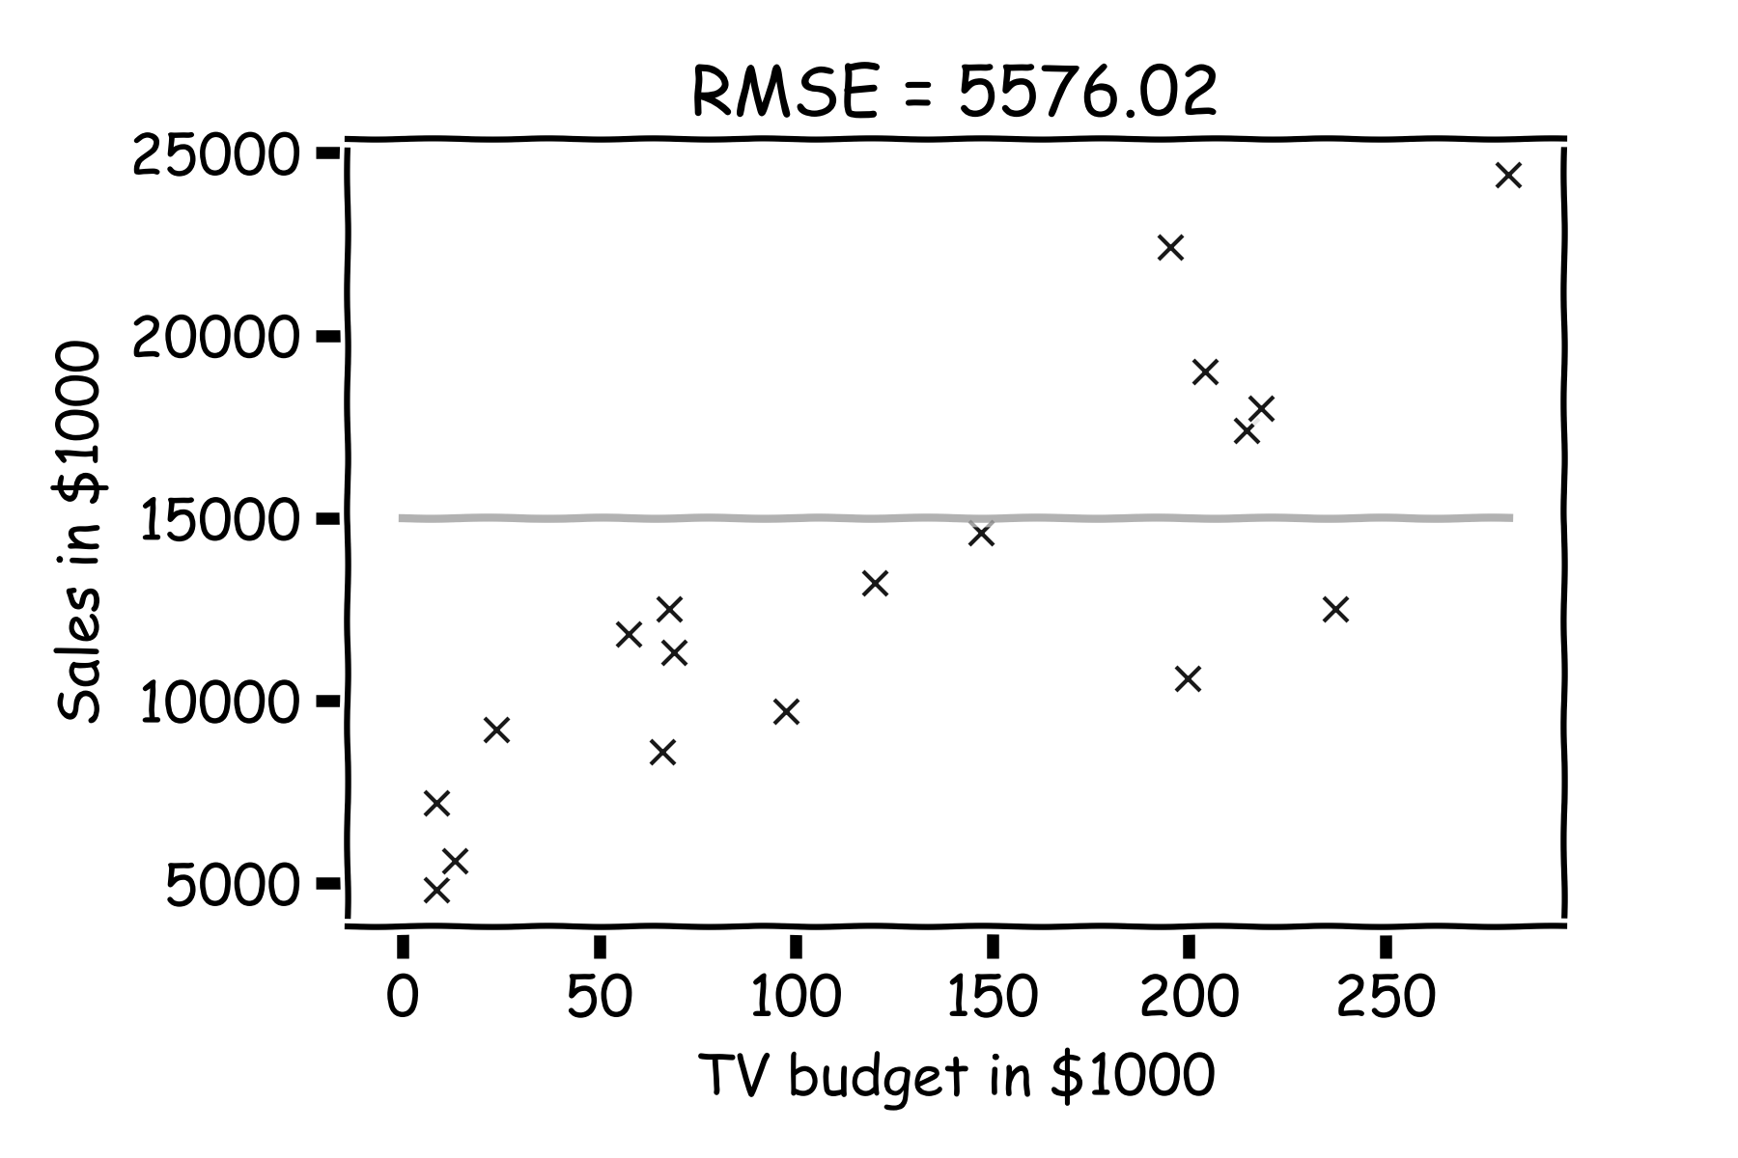
Model fitness
It is better if we compare it to something.
We will use the simplest model:
Notes:
Change this to a nicer plot
The subscript on the summation should be i=1 for clarity. I can’t seem to change this either… (DLS)

Slide 59
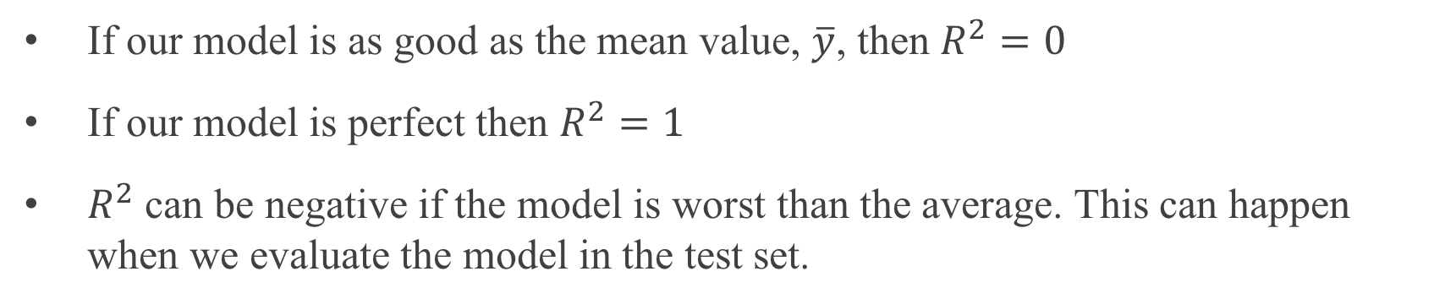
R-squared
If our model is as good as the mean value, $\overline{y}$, then $R^{2}=0$
If our model is perfect then $R^{2}=1$
$R^{2}$ can be negative if the model is worst than the average. This can happen when we evaluate the model in the test set.
Notes:
Change this to a nicer plot

Slide 60
Linear Regression

Slide 61
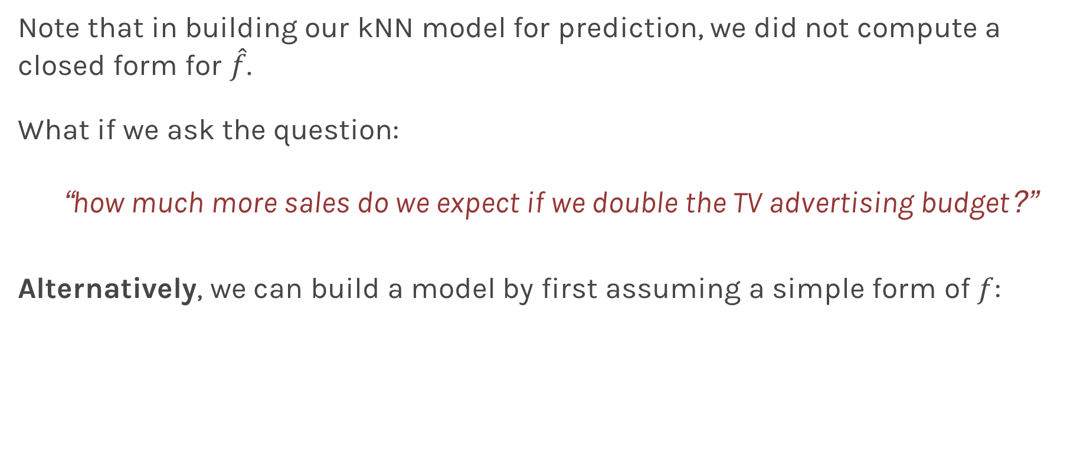
Linear Models
Note that in building our kNN model for prediction, we did not compute a closed form for $\hat{f}$.
What if we ask the question:
“how much more sales do we expect if we double the TV advertising budget?”
Alternatively, we can build a model by first assuming a simple form of $f$:

Slide 62
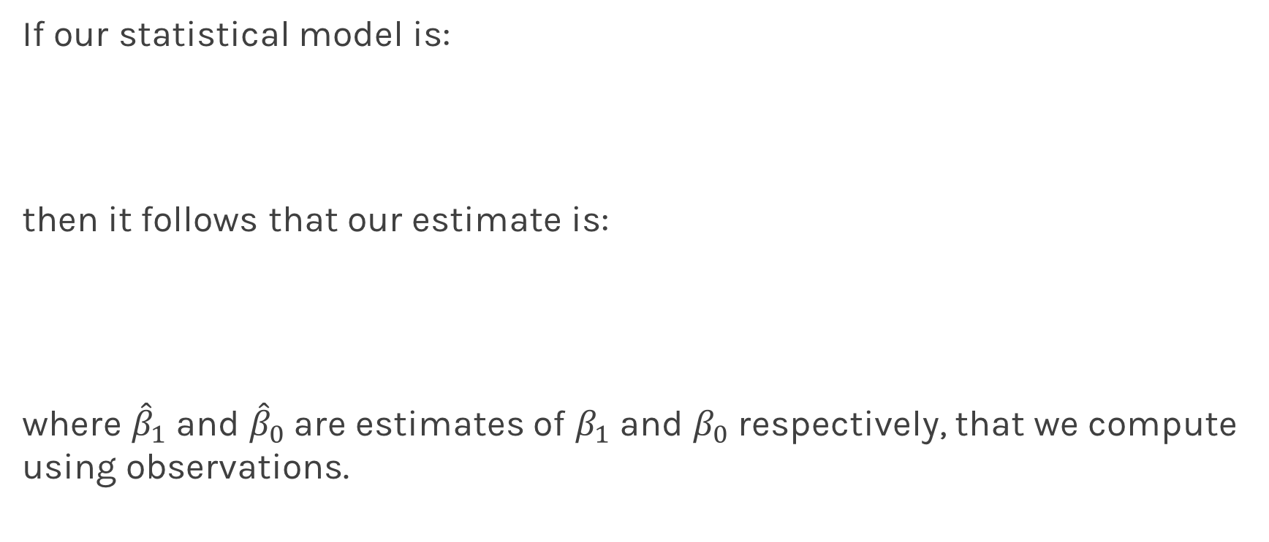
Linear Regression
If our statistical model is:
then it follows that our estimate is:
where ${\hat{β}}_{1}$ and ${\hat{β}}_{0}$are estimates of $β_{1}$ and $β_{0}$ respectively, that we compute using observations.

Slide 63
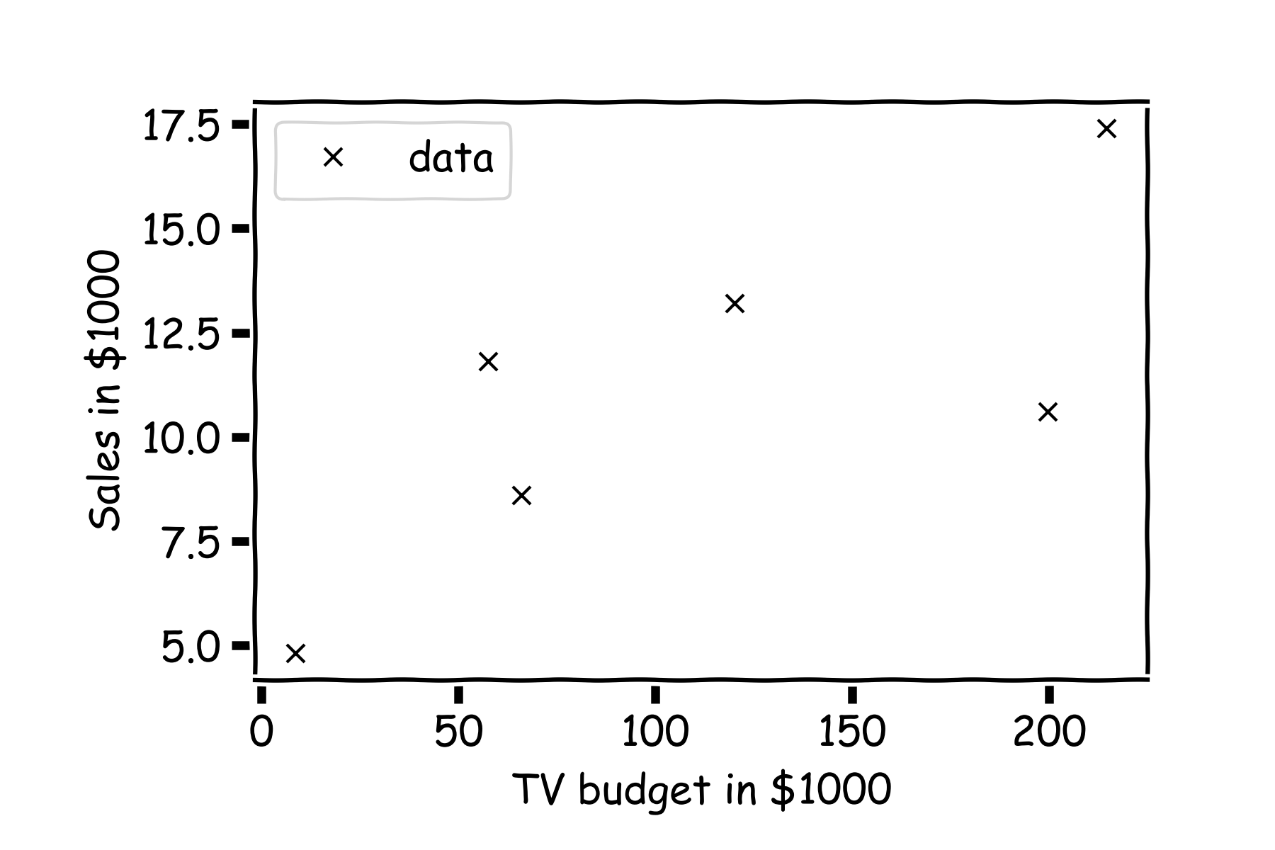
Linear Regression
For a given data set

Slide 64
Linear Regression
Is this line good?

Slide 65
Linear Regression
Maybe this one?

Slide 66
Linear Regression
Or this?

Slide 67
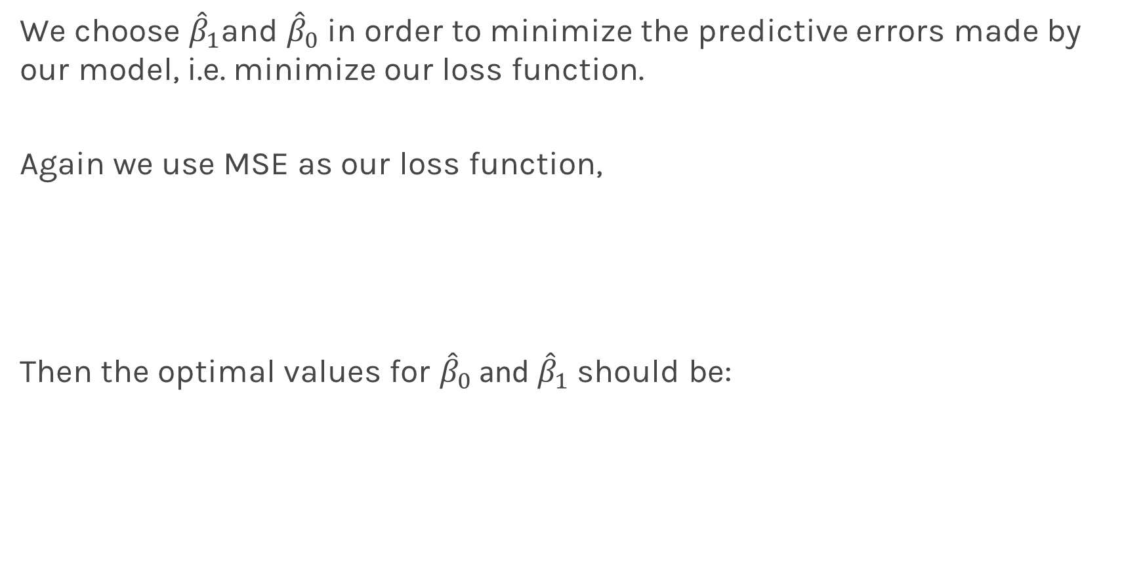
Inference for Linear Regression
We choose ${\hat{β}}_{1}$and ${\hat{β}}_{0}$ in order to minimize the predictive errors made by our model, i.e. minimize our loss function.
Again we use MSE as our loss function,
Then the optimal values for ${\hat{β}}_{0}$ and ${\hat{β}}_{1}$ should be:

Slide 68
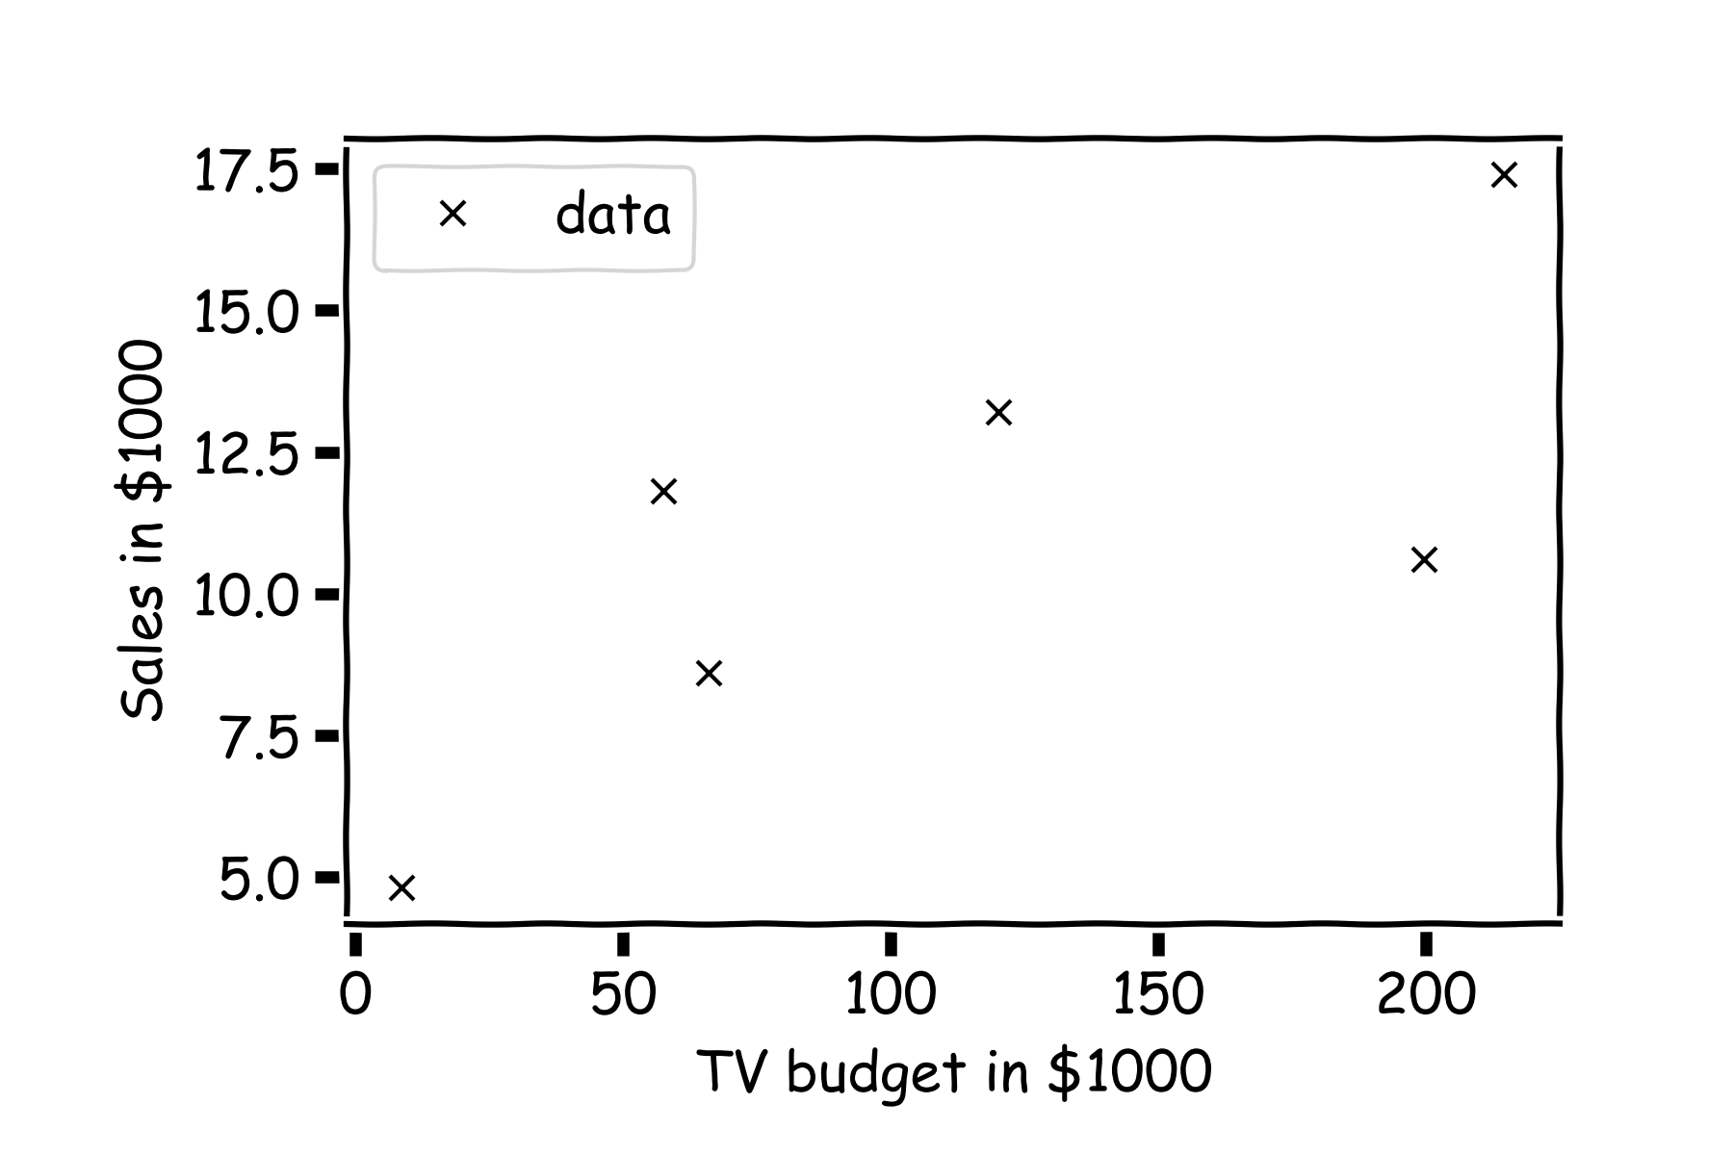
Inference for Linear Regression
First calculate the residuals

Slide 69


Linear Regression
And calculate the loss function for every possible $β_{0}$ and $β_{1}$. Find the $β_{0}$ and $β_{1}$ where the loss function is minimum.
E.g. the loss function for different $β_{1}$ ($β_{0}$is fixed to be 6).
Notes:
Should you mention that this would be a ``numerical’’ approach? (DLS)

Slide 70

Alternatively:
Take the partial derivatives of $L$ with respect to $β_{0}$ and $β_{1}$, set to zero, and find the minimum. This procedure will give us explicit formulae for ${\hat{β}}_{0}$ and ${\hat{β}}_{1}:$
where $\overline{y}$ and $\overline{x}$are sample means.
The line:
is called the regression line.
Notes:
Should you mention that this is the analytical approach? (DLS)

Slide 71
Things to Consider
Comparison of Two Models
How do we choose from two different models?
Model Fitness
How does the model perform predicting?
Evaluating Significance of Predictors
Does the outcome depend on the predictors?
How well do we know $\hat{f}$
The confidence intervals of our $\hat{f}$

Slide 72
Evaluating Significance of Predictors

Slide 73


Evaluating Significance of Predictors
We interpret the $ε$term in our observation
to be noise introduced by random variations in natural systems or imprecisions of our scientific instruments.
If we knew the exact form of $f\left(x\right),$for example, $f\left(x\right)=β_{0}+β_{1}x$, and there was no $ε$ then estimating the ${\hat{β}}^{′}s$ would have been exact.
Notes:
Axes labels! (DLS)

Slide 74

Evaluating Significance of Predictors
However, three things happen:
we do not know the exact form of $f\left(x\right)$
$ε$ is always there
limited sample size
We first address $ε$
We call $ε$the measurement error or irreducible error. Since even predictions made with the actual function $f$ will not match observed values of $y$.
Because of $ε,$ every time we measure the response $Y$ for a fix value of $X$we will obtain a different observation, and hence a different estimate of ${\hat{β}}^{′}s.$

Slide 75

Evaluating Significance of Predictors
Start with a model

Slide 76

Evaluating Significance of Predictors
For a some values of $X,$ $Y=f(X)$

Slide 77

Evaluating Significance of Predictors
But due to error, every time we measure the response Y for a fixed value of X we will obtain a different observation.

Slide 78

Evaluating Significance of Predictors
One set of observations, “one realization” we obtain one set of Ys (red crosses).

Slide 79

Evaluating Significance of Predictors
Another set of observations, “another realization” we obtain another set of Ys (green crosses).

Slide 80

Evaluating Significance of Predictors
Another set of observations, “another realization” we obtain another set of Ys (black crosses).

Slide 81


Evaluating Significance of Predictors
For each one of those “realizations”, we could fit a model and estimate, ${\hat{β}}_{0}$ and ${\hat{β}}_{1}.$

Slide 82

Evaluating Significance of Predictors
For each one of those “realizations”, we could fit a model and estimate, ${\hat{β}}_{0}$ and ${\hat{β}}_{1}.$

Slide 83

Evaluating Significance of Predictors
For each one of those “realizations”, we could fit a model and estimate, ${\hat{β}}_{0}$ and ${\hat{β}}_{1}.$

Slide 84

Evaluating Significance of Predictors
$$.$$
Repeat this on real data. We now select a sub-sample from all the data.

Slide 85

Evaluating Significance of Predictors
Another sub-sample.

Slide 86

Evaluating Significance of Predictors
Another sub-sample.

Slide 87

Evaluating Significance of Predictors
Another sub-sample.

Slide 88

Evaluating Significance of Predictors
Repeat this for 100 times.

Slide 89

Evaluating Significance of Predictors
We can estimate the mean and standard deviation of the estimate ${\hat{β}}_{1}$

Slide 90


Evaluating Significance of Predictors
We can calculate the confidence intervals, which are the ranges of values such that the true value of $β_{1}$is contained in this interval with n percent probability.
95%
68%

Slide 91



Now we can answer the question, “how significant are the predictors?” Here we show the same analysis for all three predictors.
Question: Which ones are important?

Slide 92



We examine how consistent the estimated values of the coefficients are with zero. Looking at the area under the curve below zero.
This is called hypothesis testing which we will visit again later next lecture.

Slide 93

Evaluating Significance of Predictors
However, three things happen:
we do not know the exact form of $f\left(x\right)$
$ε$ is always there
Sample size
We now address sample size
As we saw in Lecture 1b, sample estimates are approximation to population means … blah balh
Let’s think how this affects our estimate of predictors and how this affects are conclusions on the significance of the predictors.
Notes:
Aleatoric error? (DLS)

Slide 94
Estimate Uncertainty for Coefficients
Once we have the distribution,

Slide 95
Estimate Uncertainty for Coefficients
Once we have the distribution, we can calculate the mean and variance.

Slide 96
Estimate Uncertainty for Coefficients
And then we calculate the confidence intervals and the importance of the predictors.

Slide 97
Sample size
Let’s re-examine this more carefully.
Notes:
[RD: ADD WHATEVER YOU WANT HERE ABOUT POPULATION VS SAMPLE]

Slide 98

Sample size
Let’s re-examine this more carefully.
In statistics, any estimate value is subject to sample size:
The estimated value, is called the sample mean
Whereas $E[x]$ is called the population mean
Notes:
[RD: ADD WHATEVER YOU WANT HERE ABOUT POPULATION VS SAMPLE]

Slide 99



TV | sales
230.1 | 22.1
44.5 | 10.4
17.2 | 9.3
151.5 | 18.5
180.8 | 12.9
8.7 | 7.2
57.5 | 11.8
120.2 | 13.2
8.6 | 4.8
199.8 | 10.6
66.1 | 8.6
214.7 | 17.4
23.8 | 9.2
97.5 | 9.7
204.1 | 19.0
195.4 | 22.4
67.8 | 12.5
281.4 | 24.4
69.2 | 11.3
147.3 | 14.6
Notes:
Here show how sub-sampling works ?

Slide 100



Bigger the sample less variation in the prediction

Slide 101

How do $μ_{β}$ and $σ_{β}$ depend on $ε, \hat{f}$, and number of samples?
Assume we know the functional form of $f,$we examine the relationship to number of samples.

Slide 102

How do $μ_{β}$ and $σ_{β}$ depend on $ε, \hat{f}$, and number of samples?
Notes:
Show the sub-sample size

Slide 103

How do $μ_{β}$ and $σ_{β}$ depend on $ε, \hat{f}$, and number of samples?
We used sub-sample size 50 before
Notes:
Show the sub-sample size

Slide 104

How do $μ_{β}$ and $σ_{β}$ depend on $ε, \hat{f}$, and number of samples?
However, we should have used sub-sample size 200.
Notes:
Show the sub-sample size

Slide 105
Bootstrap

Slide 106
Bootstrap
Imagine we have 5 billiard balls in a bucket.

Slide 107
Bootstrap
We first pick randomly a ball and replicate it. This is called sampling with replacement.
We move the replicated ball to another bucket.

Slide 108
Bootstrap

Slide 109
Bootstrap
We then pick randomly another ball and again we replicate it.
Again, we then move the replicated ball to the other bucket.

Slide 110
Bootstrap

Slide 111
Bootstrap
We repeat this process.
Notes:
Fix this with true replacement

Slide 112
Bootstrap
Again

Slide 113
Bootstrap
And again

Slide 114
Bootstrap
Until the other bucket has the same number of balls as the original one.

Slide 115
Bootstrap
We repeat the same process and acquire another sample

Slide 116
Bootstrap
We repeat the same process and acquire another sample

Slide 117

Bootstrapping for Estimating Sampling Error
Definition
Bootstrapping is the practice of estimating properties of an estimator by measuring those properties by, for example, sampling from the observed data.
For example, we can compute ${\hat{β}}_{0}$ and ${\hat{β}}_{1}$multiple times by randomly sampling from our data set. We then use the variance of our multiple estimates to approximate the true variance of ${\hat{β}}_{0}$ and ${\hat{β}}_{1}$.

Slide 118

Standard Errors
The variance of $β_{0}$ and $β_{1}$ are also called their standard errors, $SE\left({\hat{β}}_{0}\right),SE\left({\hat{β}}_{1}\right).$
If our data is drawn from a larger set of observations then we can empirically estimate the standard errors, $SE\left({\hat{β}}_{0}\right),SE\left({\hat{β}}_{1}\right)$ of $β_{0}$ and $β_{1}$through bootstrapping.
If we know the variance $σ^{2}$ of the noise $ε$, we can compute $SE\left({\hat{β}}_{0}\right),SE\left({\hat{β}}_{1}\right)$ analytically, using the formulae below:
Notes:
If data set is small this approximation does not work

Slide 119

Standard Errors
In practice, we do not know the theoretical value of $σ$ since we do not know the exact distribution of the noise $ε$. However, if we make the following assumptions,
the errors $ε_{i}=y_{i}−{\hat{y}}_{i}$and $ε_{j}=y_{j}−{\hat{y}}_{j}$ are uncorrelated, for $i≠j$ ,
each $ε_{i}$ is normally distributed with mean 0 and variance $σ^{2}$,
then, we can empirically estimate $σ^{2}$, from the data and our regression line:

Slide 120

Standard Errors
Exercise: Duplicate the following results for the coefficients for TV advertising.
Method | $$SE\left({\hat{β}}_{0}\right)$$ | $$SE\left({\hat{β}}_{1}\right)$$
Analytic Formula | 0.353 | 0.0023
Bootstrap | 0.328 | 0.0028

Slide 121

Importance of predictors
We have discussed finding the importance of predictors, by determining the cumulative distribution from $∞$ to 0.
.

Slide 122


Importance of predictors
This is equivalent in looking the distance of the estimated value of the coefficient in units of SE(${\hat{β}}_{1}$) = $σ_{{\hat{β}}_{1}}$.
.
$$μ_{{\hat{β}}_{1}}−0$$
$$σ_{{\hat{β}}_{1}}$$

Slide 123

Hypothesis Testing
Hypothesis testing is a formal process through which we evaluate the validity of a statistical hypothesis by considering evidence for or against the hypothesis gathered by random sampling of the data.
State the hypotheses, typically a null hypothesis, $H_{0}$ and an alternative hypothesis, $H_{1}$, that is the negation of the former.
Choose a type of analysis, i.e. how to use sample data to evaluate the null hypothesis. Typically this involves choosing a single test statistic.
Sample data and compute the test statistic.
Use the value of the test statistic to either reject or not reject the null hypothesis.

Slide 124
Hypothesis testing
1. State Hypothesis:
Null hypothesis:
$H_{0}$: There is no relation between X and Y
The alternative:
$H_{a}$: There is some relation between X and Y
2: Choose test statistics
To test the null hypothesis, we need to determine whether, our estimate for ${\hat{β}}_{1}$, is sufficiently far from zero that we can be confident that ${\hat{β}}_{1}$ is non-zero. We use the following test statistic:

Slide 125

Hypothesis testing
3. Sample:
Using bootstrap we can estimate ${\hat{β}}_{1}.$
4. Reject or not reject the hypothesis:
If there is really no relationship between X and Y , then we expect that will have a t-distribution with n-2 degrees of freedom.
To compute the probability of observing any value equal to $|t|$ or larger, assuming ${\hat{β}}_{1}=0$ is easy. We call this probability the p-value.
a small p-value indicates that it is unlikely to observe such a substantial association between the predictor and the response due to chance

Slide 126


Hypothesis testing
P-values for all three predictors done independently
Method | $$SE\left({\hat{β}}_{0}\right)$$ | $$SE\left({\hat{β}}_{1}\right)$$
Analytic Formula | 0.353 | 0.0023
Bootstrap | 0.328 | 0.0028
Method | $$SE\left({\hat{β}}_{0}\right)$$ | $$SE\left({\hat{β}}_{1}\right)$$
Analytic Formula | 0.353 | 0.0023
Bootstrap | 0.328 | 0.0028
Method | $$SE\left({\hat{β}}_{0}\right)$$ | $$SE\left({\hat{β}}_{1}\right)$$
Analytic Formula | 0.353 | 0.0023
Bootstrap | 0.328 | 0.0028

Slide 127
Things to Consider
Comparison of Two Models
How do we choose from two different models?
Model Fitness
How does the model perform predicting?
Evaluating Significance of Predictors
Does the outcome depend on the predictors?
How well do we know $\hat{f}$
The confidence intervals of our $\hat{f}$

Slide 128

How well do we know $\hat{f}$?
Our confidence in $f$ is directly connected with the confidence in $β$s. So for each $β$ we can make a prediction.

Slide 129

How well do we know $\hat{f}$?
Here we show two difference set of predictions given the fitted coefficioents for a given subsample

Slide 130

How well do we know $\hat{f}$?
There is one such regression line for every imaginable sub-sample.

Slide 131


How well do we know $\hat{f}$?
Below we show all regression lines for a thousand of such sub-samples.
For a given $x$, we examine the distribution of $\hat{y}$, and determine the mean and standard deviation.

Slide 132

How well do we know $\hat{f}$?
For every $x$, we calculate the mean of the predictions, $\hat{y}$ (shown with dotted line) and the 95% CI of those predictions (shaded area).

Slide 133
What’s next?
So far we have examined only one predictor at the time. Next lecture we will see how to use multiple predictors together and evaluate the significance of each predictor when cofounding effects are present.
In this lecture we used sub-samples to estimate the CI. Next lecture we will introduce bootstrapping, a trick for re-using the data to estimate the CI.

Slide 134
Multiple Linear Regression

Slide 135
Response vs. Predictor Variables
X
predictors
features
covariates
Y
outcome
response variable
dependent variable
TV | radio | newspaper | sales
230.1 | 37.8 | 69.2 | 22.1
44.5 | 39.3 | 45.1 | 10.4
17.2 | 45.9 | 69.3 | 9.3
151.5 | 41.3 | 58.5 | 18.5
180.8 | 10.8 | 58.4 | 12.9
n observations
p predictors

Slide 136

Multilinear Models
In practice, it is unlikely that any response variable Y depends solely on one predictor x. Rather, we expect that is a function of multiple predictors $f(X_{1},…,X_{J})$. Using the notation we introduced last lecture,
$Y=y_{1},…,y_{n}$, $X=X_{1},…,X_{J}$and$X_{j}=x_{1j},…,x_{ij},…,x_{nj}$
In this case, we can still assume a simple form for $f$-a multilinear form:
Hence, $\hat{f}$, has the form
Notes:
We need a figure here

Slide 137

Multiple Linear Regression
Again, to fit this model means to compute ${\hat{β}}_{0},…,{\hat{β}}_{J}$we minimize a loss function; we will again choose the MSE as our loss function.
Given a set of observations,
the data and the model can be expressed in vector notation,
Notes:
We need a figure here

Slide 138
Multiple Linear Regression
The model takes a simple algebraic form:
Thus, the MSE can be expressed in vector notation as
Minimizing the MSE using vector calculus yields,
Notes:
We need a figure here

Slide 139

Finding Significant Predictors: Hypothesis Testing
For checking the significance of linear regression coefficients:
we set up our hypotheses $H_{0}$:
we choose the F-stat to evaluate the null hypothesis,

Slide 140

Finding Significant Predictors: Hypothesis Testing
we can compute the F-stat for linear regression models by
If $F=1$ we consider this evidence for $H_{0}$; if $F>1$, we consider this evidence against $H_{0}$.

Slide 141
Qualitative Predictors
So far, we have assumed that all variables are quantitative. But in practice, often some predictors are qualitative.
Example: The Credit data set contains information about balance, age, cards, education, income, limit , and rating for a number of potential customers.
Income | Limit | Rating | Cards | Age | Education | Gender | Student | Married | Ethnicity | Balance
14.890 | 3606 | 283 | 2 | 34 | 11 | Male | No | Yes | Caucasian | 333
106.02 | 6645 | 483 | 3 | 82 | 15 | Female | Yes | Yes | Asian | 903
104.59 | 7075 | 514 | 4 | 71 | 11 | Male | No | No | Asian | 580
148.92 | 9504 | 681 | 3 | 36 | 11 | Female | No | No | Asian | 964
55.882 | 4897 | 357 | 2 | 68 | 16 | Male | No | Yes | Caucasian | 331

Slide 142
Qualitative Predictors
If the predictor takes only two values, then we create an indicator or dummy variable that takes on two possible numerical values.
For example for the gender, we create a new variable:
We then use this variable as a predictor in the regression equation.

Slide 143
Qualitative Predictors
Question: What is interpretation of $β_{0}$ and $β_{1}$?

Slide 144

Qualitative Predictors
Question: What is interpretation of $β_{0}$ and $β_{1}$?
$β_{0}$ is the average credit card balance among males,
$β_{0}+β_{1}$ is the average credit card balance among females,
and $β_{1}$ the average difference in credit card balance between females and males.
Exercise: Calculate $β_{0}$ and $β_{1}$ for the Credit data.
You should find $β_{0}\sim \$509,β_{1}\sim \$19$

Slide 145
More than two levels: One hot encoding
Often, the qualitative predictor takes more than two values (e.g. ethnicity in the credit data).
In this situation, a single dummy variable cannot represent all possible values.
We create additional dummy variable as:

Slide 146
More than two levels: One hot encoding
We then use these variables as predictors, the regression equation becomes:
Again the interpretation
Notes:
[ADD interpretation and ONE HOT ENCODING]

Slide 147

Beyond linearity
In the Advertising data, we assumed that the effect on sales of increasing one advertising medium is independent of the amount spent on the other media.
If we assume linear model then the average effect on sales of a one-unit increase in TV is always $β_{1}$, regardless of the amount spent on radio.
Synergy effect or interaction effect states that when an increase on the radio budget affects the effectiveness of the TV spending on sales.

Slide 148
Beyond linearity
We change
To

Slide 149

What does it mean?

Slide 150
Predictors predictors predictors
We have a lot predictors!
Is it a problem?
Yes: Computational Cost
Yes: Overfitting
Wait there is more …

Slide 151
Polynomial Regression

Slide 152

Polynomial Regression
The simplest non-linear model we can consider, for a response Y and a predictor X, is a polynomial model of degree M,
Just as in the case of linear regression with cross terms, polynomial regression is a special case of linear regression - we treat each $x^{m}$ as a separate predictor. Thus, we can write

Slide 153
Polynomial Regression
Again, minimizing the MSE using vector calculus yields,

